Slide 1
RELATIONAL MODEL

Slide 2
RELATIONAL DATABASE:
A relational database is a collection of related information stored in two dimensional tables . When we are able to connect these tables, then it is known as relational database system and how we can manage and access data from these tables in a desired manner, then it is known as relational database management system(RDBMS).

Slide 3
RELATIONAL MODEL CONCEPTS:
In relational model the database is represented as a collection of tables. Some Relational model concepts are:-
Table
Relation
Tuple
Attribute
Domain
Cardinality
Degree

Slide 4
SID | NAME | TRADE | GRADE
1 | RAJESH | CSE | A
2 | VIKAS | ECE | B
3 | GEETA | CSE | B
4 | MADHU | ECE | C
5 | SAVITA | DBM | A
Name of
the attribute
Value of the
attribute
Domain for the SID attribute
Tuple or
Record or
Segment
RELATIONAL MODEL CONCEPTS

Slide 5
TABLE: A relationship database table is a rectangular row column arrangement of data values.
RELATION: A relation is a two dimensional table with special properties. It consists of a number of rows and columns. In other words , it may be defined as a set of tuples.
TUPLE: A row that contains various data about an entity in a table is called a tuple. Infact, it is a record in a relation.
ATTRIBUTE: A column in a table is called attribute.

Slide 6
DOMAIN: A domain is a set of predefined value(or value range) that may appear in one or more columns.
CARDINALITY: The number of tuples in a relation is called cardinality of the relation.
DEGREE: The number of attributes in a relation is known as degree of the relation. Relation of degree one are said to be unary, relations of degree two are called binary, relations of degree three are called tertiary and similarly relations of degree n are called n-ary relations.

Slide 7
RELATIONS
Mathematical relation: Suppose that we have two sets , D1 & D2 with D1={1,3} and D2={2,4,8}. The cartesian product of these two sets written as D1×D2.
D1×D2={(1,2),(1,4),(1,8),(3,2),(3,4),(3,8)}
A relation is simply some subset of this cartesian product.
For example: A relation R includes all those ordered pairs in which the second element is 2 , then
R={(1,2),(3,2)}

Slide 8
PROPERTIES OF RELATION
In a table, the order of rows is immaterial.
Order of columns is immaterial.
In a table,there are no duplicate rows.
Each row of table contains only one value.
In a table, the values in each column must come from the same attribute domain.

Slide 9
REPRESENTING RELATIONAL DATABASE STRUCTURES
The relation scheme would be written as
student(stuid,sname,subject,marks)
class(courses#,facid,room)
faculty(facid,fname,dept,rank)
enrollment(course#,stuid,grade)

Slide 10
KEYS
PRIMARY KEY
SECONDARY KEY
CANDIDATE KEY
ALTERNATE KEY
FOREIGN KEY
SUPER KEY

Slide 11
STUDENT
SID | REGNO | NAME | TRADE | GRADE
1 | DSC8 | RAJESH | CSE | A
2 | DKJ6 | VIKAS | ECE | B
3 | DHI7 | GEETA | CSE | B
4 | DEL5 | MADHU | ECE | C
5 | DHI6 | SAVITA | DBM | A

Slide 12
Primary key: An attribute which recognize a tuple uniquely is called a primary key. For example: SID is a primary key. Primary key can have more than one attribute such type of key is called a concatenated key. ▪Secondary key: Secondary key recognizes the tuple but not uniquely. For example : Name , Trade and Grade are the seconadary keys in STUDENT relation.

Slide 13
Candidate key: There may be more than one attributes in a relation such that they recognize a tuple uniquely(i.e. each of the attribute have the property of primary key ). These attributes are called candidate key. For example: In STUDENT relation, SID and REGNO are the candidate key.
Alternate key: From the candidate keys,we choose one as a primary key. Now candidate key which is not primary key is called alternate key. For example: In STUDENT relation, if we choose SID as a primary key, then REGNO is the alternate key.

Slide 14
Foreign key: A foreign key is an attribute of a relation that is primary key of another relation. In below example, DNO is a foreign key .
EMP
DEPT
ENO | NAME | AGE | DNO
1 | Sunny | 22 | 10
2 | Mohit | 28 | 11
3 | Ajit | 27 | 10
DNO | DLOC
10 | Karnal
11 | Ambala
Super key: A set of attributes is called a superkey ,if it recognize the tuple uniquely. For example: In STUDENT relation, SID+NAME+CITY is a super key .

Slide 15
EXTENSIONS AND INTENSIONS
A relation in a relational database actually has two componenets.
An extension
An intension
Extension:The extension of a given relation is the set of tuples appearing in that relation , at any given instant.Instance of schema is also known as Extension.
Intension:The intension of a given relation is independent of time.The intension is the combination of two things: a naming structure and a set of integrity constraints. The schema is also known as intension.
The naming structure consists of relation name plus the name of the attributes.
The integrity constraints are integrity rule I and integrity rule II.

Slide 16
RELATIONAL CONSTRAINTS
Here we discuss the various restrictions on data that can be specified on a relational database schema in the form of constraints.
Domain Constraints: It specifies that the value of each attribute X must be an atomic value from the domain of X .
For example:
STUDENT
Not allowed
because Age is
integer attribute
ROLL_NO | NAME | AGE
1001 | Shivani | 18
1002 | Smriti | 17
1003 | Monika | A

Slide 17
Tuple uniqueness constraints : Relation is defined as a set of tuples . By definition, all elements of a set are distinct. Hence, all tuples in a relation must also be distinct.
ROLL_NO | NAME | AGE
1001 | Shivani | 18
1002 | Smriti | 20
1001 | Shivani | 18
Not allowed

Slide 18
Key Constraints : Primary key must have unique value in the relational table. For example , if ROLL_NO is primary key then STUDENT
ROLL_NO | NAME | AGE
1001 | Shivani | 18
1002 | Smriti | 19
1001 | Monika | 20
Not allowed

Slide 19
Integrity rule 1 (Entity Integrity)
It states that the attribute(s) that compose the primary key cannot have duplicate or null value.
STUDENT
ROLL_NO | NAME | AGE
1001 | Shivani | 15
 | Smriti | 17
1003 | Puja | 18
 | Jagriti | 19
Not allowed
Not allowed

Slide 20
Integrity rule 2(Referencial Integrity rule):
It states that if a foreign key in table A refers to the primary key of table B , then every value of the foreign key in table A must be null or be available in table B .
For example: Here DNO is a foreign key in EMP relation
EMP DEPT
ENO | NAME | AGE | DNO
1 | Sunny | 22 | 10
2 | Mohit | 24 | 11
3 | Ajit | 27 | 10
4 | Ajay | 29 | 15
DNO | DLOC
10 | Karnal
11 | Ambala
Not
Allowed

Slide 21
CONCEPT OF NULL
In a relation, the null represents a value of an attribute that may correspond to missing information , unknown information or inapplicable data.They are not values and are not same as text string filled with spaces or zero numeric values .For example:
STUDENT
SID | NAME | AGE
1 | Anita | 10
2 | Ajay
3 | Smriti | 19
4 | Priya | 10.5
Missing
Unknown
Inapplicable

Slide 22
RELATION AND THEIR SCHEMES
A homogeneous set of tuples makes a relation. Two parts of a relation are:-
Relation scheme or header
Time varying set of tuples of body
In a relation, the set of attributes remains invarient and the tuples are defined on them. This is called the relation scheme. On the other hand, the set of tuples in the relation are not static but can vary with time and this makes the body of the relation called time varying set of tuples.

Slide 23
Chapter 2
Functional
Dependencies

Slide 24
Functional Dependency
A functional dependency is a relationship
between attributes, we can obtain the value of
another attribute.

Slide 25
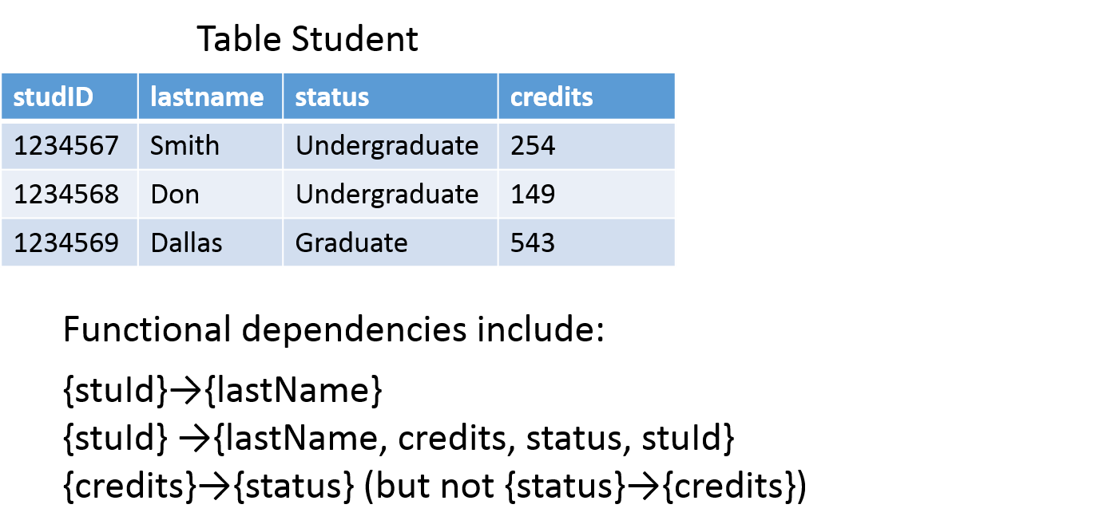

Slide 26
Fully Functional Dependency
In a relation R, an attribute Y is said to be fully
functionally dependent on attribute X if it is
functionally dependent on X and not
functionally dependent on any proper subset of X.

Slide 27
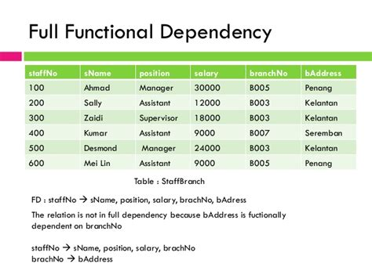

Slide 28
Trivial and Non trivial Dependency
Trivial FD: An FD is trivial if and only if the right hand side is a subset of the left hand side.
Example:
(S#, p#)->S#
For example:
Consider a table with two columns Student_id and Student_Name.
{Student_Id, Student_Name} -> Student_Id is a trivial functional dependency as Student_Id is a subset of {Student_Id, Student_Name}. That makes sense because if we know the values of Student_Id and Student_Name then the value of Student_Id can be uniquely determined.

Slide 29
NONTRIVIAL DEPENDENCIES
Nontrivial FD: An FD which is not a trivial FD is
known as nontrivial FD.
Example:
X->Y
For example: An employee table with three attributes: emp_id, emp_name, emp_address. The following functional dependencies are non-trivial: emp_id -> emp_name (emp_name is not a subset of emp_id) emp_id -> emp_address (emp_address is not a subset of emp_id)

Slide 30
Inference Rules for Functional Dependencies
Let S is the set of functional dependencies that
are specified on relation schema R. Numerous
other dependencies can be inferred or deduced
from the FDs in S. The set of all such
Dependency is called the closure of S and is
denoted by S.
Example:
Let S={A->B
B->c}
We infer the following functional dependency from S:
A->C

Slide 31
Armstrong’s Inference Rules
1.Reflexivity
If B is a subset of A, then A->B.
2.Augmentation
If A->B, then AC->BC.
3.Transitivity
If A->B and B->C, then A->C.

Slide 32
Armstrong’s Inference Rules
4. Decomposition rule: If A->BC, then A->B and A->C
Proof:
Step 1:A->BC (Given)
Step 2:BC->B (Using rule 1)
Step 3:A->B (Using rule 3,step 1 and step 2)

Slide 33
Armstrong’s Inference Rule
5. Union or additive rule
If A->B and A->C, then A->BC
Proof:
Step1: A->B(Given)
Step2:A->C (Given)
Step3:A->AB (Using rule 2 on step 1)
Step4:AB->BC (Using rule 2 on step 2)
Step5:A->BC (Using rule 3 on step 3 and step 4)

Slide 34
Equivalence of sets of Functional Dependencies
Two sets of functional dependencies E and F are Equivalent if E+= F+. Hence equivalence means that every FD in E can be inferred from F, and every FD in F can be inffered from E.

Slide 35
Chapter 2
Normalization

Slide 36
Normalization
Database normalization is the process of restructuring a relational database in accordance with a series of so-called normal forms in order to reduce data redundancy and improve data integrity.

Slide 38
Modification Anomalies
Changing the data in some relation can have undesirableconsequences called modification anomalies.

Slide 39
These three Update Anomalies are having different impact on our database.
Insertion Anomalies create the problems when we are creating the inconsistency in the RDBMS database
while inserting the records into the columns of the given
table.
Deletion Anomalies create the problems when we are
deleting the records without taking care of the other
portion of the database. It will create the confusion due
to inconsistency in the database.
Modification Anomalies are occurs when we are not
able to modifying the records in the data base without
taking care of the other facts.

Slide 40
First Normal Form (1NF)
For a table to be in the First Normal Form, it should follow the following 4 rules:
It should only have single(atomic) valued attributes/columns.
Values stored in a column should be of the same domain
All the columns in a table should have unique names.
And the order in which data is stored, does not matter.

Slide 41
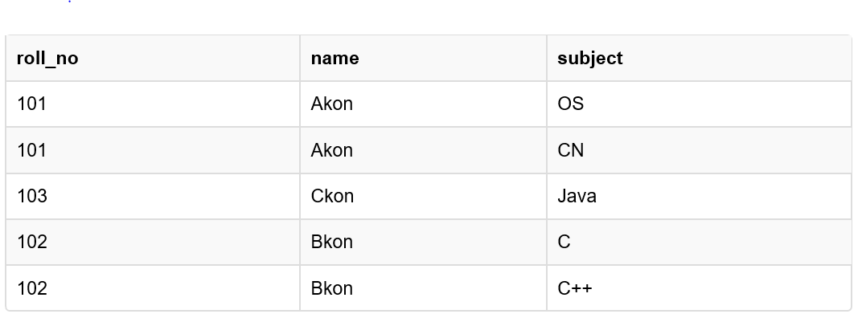
Time for an Example
How to solve this Problem?

Slide 42
Second Normal Form (2NF)
For a table to be in the Second Normal Form,
It should be in the First Normal form.
And, it should not have Partial Dependency.

Slide 43
Time for an Example
Now as we just discussed that the primary key for this table is a composition of two columns which is student_id & subject_id but the teacher's name only depends on subject, hence the subject_id, and has nothing to do with student_id.
This is Partial Dependency, where an attribute in a table depends on only a part of the primary key and not on the whole key.

Slide 44
How to remove Partial Dependency?

Slide 45
Third Normal Form (3NF)
A table is said to be in the Third Normal Form when,
It is in the Second Normal form.
And, it doesn't have Transitive Dependency.

Slide 46
Time for an Example

Slide 47
How to remove Transitive Dependency?

Slide 48
Boyce and Codd Normal Form (BCNF)
Boyce and Codd Normal Form is a higher version of the Third Normal form. This form deals with certain type of anomaly that is not handled by 3NF. A 3NF table which does not have multiple overlapping candidate keys is said to be in BCNF. For a table to be in BCNF, following conditions must be satisfied:
R must be in 3rd Normal Form
and, for each functional dependency ( X → Y ), X should be a super Key.

Slide 49
Time for an Example
Why this table is not in BCNF?

Slide 50
How to satisfy BCNF?
To make this relation(table) satisfy BCNF, we will decompose this table into two tables, student table and professor table.

Slide 51
Fourth Normal Form (4NF)
A table is said to be in the Fourth Normal Form when,
It is in the Boyce-Codd Normal Form.
And, it doesn't have Multi-Valued Dependency.

Slide 52
Time for an Example

Slide 53
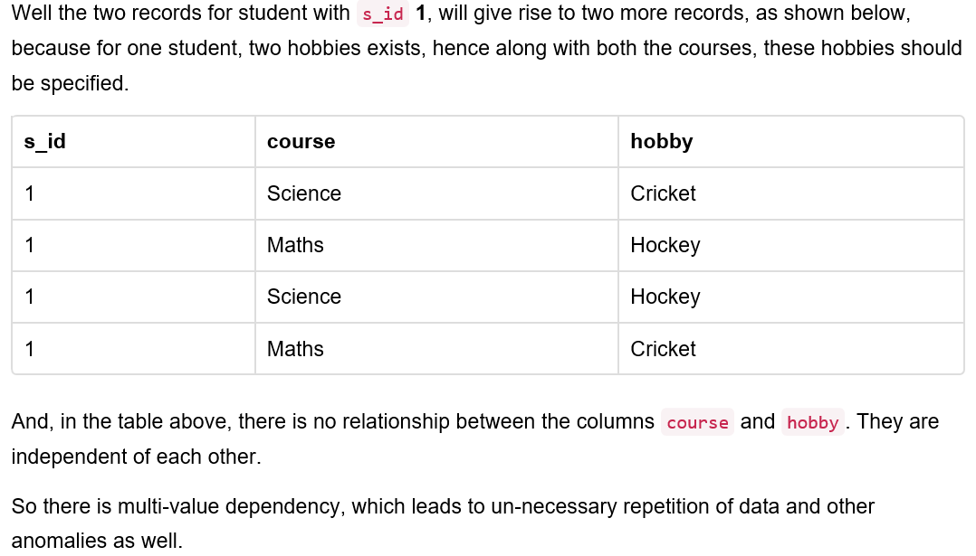

Slide 54
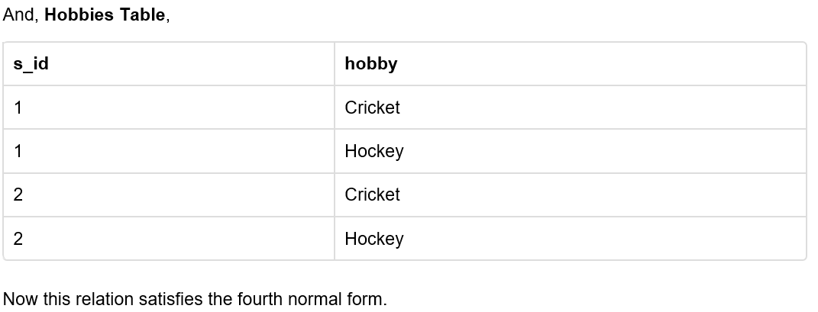
How to satisfy 4th Normal Form?

Slide 55
Fifth Normal Form (5NF)
A database is said to be in 5NF, if and only if,
It's in 4NF
If we can decompose table further to eliminate
redundancy and anomaly, and when we re-join the
decomposed tables by means of candidate keys, we
should not be losing the original data or any new
record set should not arise. In simple words, joining
two or more decomposed table should not lose
records nor create new records.

Slide 56
Consider an example of different Subjects taught by different lecturers and the lecturers taking classes for different semesters.

Slide 57
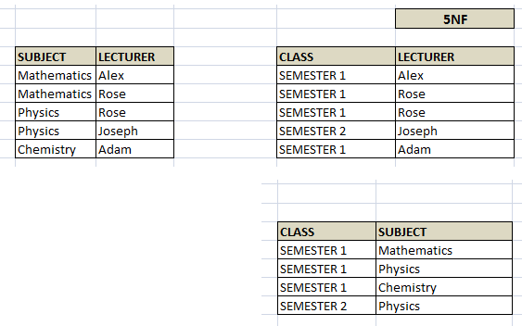
we have to decompose the table in such a way that it satisfies all the rules till 4NF and when join them by using keys, it should yield correct record. Here, we can represent each lecturer's Subject area and their classes in a better way. We can divide above table into three - (SUBJECT, LECTURER), (LECTURER, CLASS), (SUBJECT, CLASS)

Slide 58
Multi-valued Dependency
Multivalued dependency occurs when there are
more than one independent multivalued
attributes in a table.
For example: Consider a bike manufacture
company, which produces two colors (Black and
white) in each model every year.

Slide 59
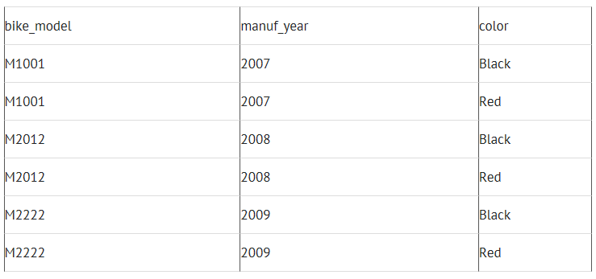
Here columns manuf_year and color are independent of each other and dependent on bike_model. In this case these two columns are said to be multivalued dependent on bike_model. These dependencies can be represented like this:
bike_model ->> manuf_year

Slide 60
Lossless Decomposition
A Decomposition that preserves all the
information of the original relation is called
Lossless Decomposition.
Lossy Decomposition
The decomposition of relation R into R1 and R2 is lossy
when the join of R1 and R2 does not yield the same relation
as in relation R.
One of the disadvantages of decomposition into two or
more relational schemes (or tables) is that some
information is lost during retrieval of original relation or
table.

Slide 61
Reference
www.studytonight.com/

Slide 62
Relational Algebra
https://courses.cs.washington.edu
Notes:
The slides for this text are organized into several modules. Each lecture contains about enough material for a 1.25 hour class period. (The time estimate is very approximate--it will vary with the instructor, and lectures also differ in length; so use this as a rough guideline.) This covers Lecture 2 (of 6) in Module (3).
Module (1): Introduction (DBMS, Relational Model)
Module (2): Storage and File Organizations (Disks, Buffering, Indexes)
Module (3): Database Concepts (Relational Queries, DDL/ICs, Views and Security)
Module (4): Relational Implementation (Query Evaluation, Optimization)
Module (5): Database Design (ER Model, Normalization, Physical Design, Tuning)
Module (6): Transaction Processing (Concurrency Control, Recovery)
Module (7): Advanced Topics

Slide 63
Relational Query Languages
Query languages: Allow manipulation and retrieval of data from a database.
Relational model supports simple, powerful QLs:
Strong formal foundation based on logic.
Allows for much optimization.
Query Languages != programming languages!
QLs not expected to be “Turing complete”.
QLs not intended to be used for complex calculations.
QLs support easy, efficient access to large data sets.

Slide 64
Formal Relational Query Languages
Two mathematical Query Languages form the basis for “real” languages (e.g. SQL), and for implementation:
Relational Algebra: More operational, very useful for representing execution plans.
Relational Calculus: Lets users describe what they want, rather than how to compute it. (Non-operational, declarative.)
Understanding Algebra & Calculus is key to
understanding SQL, query processing!

Slide 65
Preliminaries
A query is applied to relation instances, and the result of a query is also a relation instance.
Schemas of input relations for a query are fixed (but query will run regardless of instance!)
The schema for the result of a given query is also fixed! Determined by definition of query language constructs.
Positional vs. named-field notation:
Positional notation easier for formal definitions, named-field notation more readable.
Both used in Relational Algebra and SQL

Slide 66
Example Instances
R1
“Sailors” and “Reserves” relations for our examples.
We’ll use positional or named field notation, assume that names of fields in query results are `inherited’ from names of fields in query input relations.
S1
S2

Slide 67
Relational Algebra
Basic operations:
Selection ( ) Selects a subset of rows from relation.
Projection ( ) Deletes unwanted columns from relation.
Cross-product ( ) Allows us to combine two relations.
Set-difference ( ) Tuples in reln. 1, but not in reln. 2.
Union ( ∪ ) Tuples in reln. 1 and in reln. 2.
Additional operations:
Intersection, join, division, renaming: Not essential, but (very!) useful.
Since each operation returns a relation, operations can be composed! (Algebra is “closed”.)

Slide 68
Projection
Deletes attributes that are not in projection list.
Schema of result contains exactly the fields in the projection list, with the same names that they had in the (only) input relation.
Projection operator has to eliminate duplicates! (Why??)
Note: real systems typically don’t do duplicate elimination unless the user explicitly asks for it. (Why not?)

Slide 69
Selection
Selects rows that satisfy selection condition.
No duplicates in result! (Why?)
Schema of result identical to schema of (only) input relation.
Result relation can be the input for another relational algebra operation! (Operator composition.)

Slide 70
Union, Intersection, Set-Difference
All of these operations take two input relations, which must be union-compatible:
Same number of fields.
`Corresponding’ fields have the same type.
What is the schema of result?

Slide 71
Cross-Product
Each row of S1 is paired with each row of R1.
Result schema has one field per field of S1 and R1, with field names `inherited’ if possible.
Conflict: Both S1 and R1 have a field called sid.
Renaming operator:

Slide 72
Joins
Condition Join: R _{C} S = σ_{C} (R × S)
S1 _{S1.sid < R1.sid} R1
Result schema same as that of cross-product.
Fewer tuples than cross-product, might be able to compute more efficiently
Sometimes called a theta-join.

Slide 73
Joins
Equi-Join: A special case of condition join where the condition c contains only equalities and ^.
S1 _{sid} R1
Result schema similar to cross-product, but only one copy of fields for which equality is specified.
Natural Join: Equijoin on all common fields.

Slide 74
Find names of sailors who’ve reserved boat #103
Solution 1:
Solution 2:
Solution 3:

Slide 75
Find names of sailors who’ve reserved a red boat
Information about boat color only available in Boats; so need an extra join:
A more efficient solution:
A query optimizer can find this given the first solution!

Slide 76
Find sailors who’ve reserved a red or a green boat
Can identify all red or green boats, then find sailors who’ve reserved one of these boats:
Can also define Tempboats using union! (How?)
What happens if is replaced by in this query?

Slide 77
Find sailors who’ve reserved a red and a green boat
Previous approach won’t work! Must identify sailors who’ve reserved red boats, sailors who’ve reserved green boats, then find the intersection (note that sid is a key for Sailors):

Slide 78
Relational Calculus

Slide 79
Relational Calculus
Comes in two flavors: Tuple relational calculus (TRC) and Domain relational calculus (DRC).
Calculus has variables, constants, comparison ops, logical connectives, and quantifiers.
TRC: Variables range over (i.e., get bound to) tuples.
DRC: Variables range over domain elements (= field values).
Both TRC and DRC are simple subsets of first-order logic.
Expressions in the calculus are called formulas. An answer tuple is essentially an assignment of constants to variables that make the formula evaluate to true.

Slide 80
Tuple Relational Calculus
Query has the form: { T | p(T)}
Answer includes all tuples T that
make the formula p(T) be true.
Formula is recursively defined, starting with
simple atomic formulas (getting tuples from
relations or making comparisons of values),
and building bigger and better formulas using
the logical connectives.

Slide 81
TRC Formulas
Atomic formula:
R ∈ Rel, or R.a op S.b, or R.a op constant
op is one of
Formula:
an atomic formula, or
, where p and q are formulas, or
, where variable X is free in p(X), or
, where variable X is free in p(X)

Slide 82
Free and Bound Variables
The use of quantifiers ∀X and ∃X in a formula is said to bind X.
A variable that is not bound is free.
Let us revisit the definition of a query: {T|p(T)}
There is an important restriction: the variable T that appears to the left of `|’ must be the only free variable in the formula p(...).

Slide 83
Find all sailors with a rating above 7
{S | S ∈ Sailors ^ S.rating > 7}
Query is evaluated on an instance of Sailors
Tuple variable S is instantiated to each tuple of this instance in turn, and the condition “S.rating > 7” is applied to each such tuple.
Answer contains all instances of S (which are tuples of Sailors) satisfying the condition.

Slide 84
Find sailors rated > 7 who’ve reserved boat #103
{S | (S ∈ Sailors) ^ (S.rating > 7) ^ (∃ R ∈ Reserves (R.sid = S.sid ^ R.bid = 103))}
Note the use of ∃ to find a tuple in Reserves that `joins with’ the Sailors tuple under consideration.
R is bound, S is not

Slide 85
Unsafe Queries, Expressive Power
It is possible to write syntactically correct calculus queries that have an infinite number of answers! Such queries are called unsafe.
e.g.,
It is known that every query that can be expressed in relational algebra can be expressed as a safe query in DRC / TRC; the converse is also true.
Relational Completeness: Query language (e.g., SQL) can express every query that is expressible in relational algebra/calculus.

Slide 86
Summary
The relational model has rigorously defined query languages that are simple and powerful.
Relational algebra is more operational; useful as internal representation for query evaluation plans.
Relational calculus is non-operational, and users define queries in terms of what they want, not in terms of how to compute it. (Declarativeness.)
Several ways of expressing a given query; a query optimizer should choose the most efficient version.
Algebra and safe calculus have same expressive power, leading to the notion of relational completeness.

Slide 87
Unit-4
Sql components and data
defination language

Slide 88
content
SQL’s basic object
Data types
Character-String datatype
Numeric datatype
Date and Time datatype
Aggregate functions
Scalar functions
Null values
Creating database objects
Modifying database objects
Removing database objects
Reference

Slide 89
Introduction to sql
Structure Query Language(SQL) is a database query language used for storing and managing data in Relational DBMS. SQL was the first commercial language introduced for E.F Codd's Relational model of database. Today almost all RDBMS(MySql, Oracle, Infomix, Sybase, MS Access) use SQL as the standard database query language. SQL is used to perform all types of data operations in RDBMS.

Slide 90
ADVANTAGES OF SQL
Allows users to access data in the relational database management systems.
Allows users to describe the data.
Allows users to define the data in a database and manipulate that data.
Allows to embed within other languages using SQL modules, libraries & pre-compilers.
Allows users to create and drop databases and tables.
Allows users to create view, stored procedure, functions in a database.
Allows users to set permissions on tables, procedures and views.

Slide 91
Disadvantages of sql
Difficulty in Interfacing: Interfacing an SQL database is more complex than adding a few lines of code.
More Features Implemented in Proprietary way: Although SQL databases conform to ANSI & ISO standards, some databases go for proprietary extensions to standard SQL to ensure vendor lock-in.

Slide 92
An overview of sql
SQL is Structured Query Language, which is a computer language for storing, manipulating and retrieving data stored in a relational database.
SQL is the standard language for Relational Database System. All the Relational Database Management Systems (RDMS) like MySQL, MS Access, Oracle, Sybase, Informix, Postgres and SQL Server use SQL as their standard database language.
Also, they are using different dialects, such as −
MS SQL Server using T-SQL,
Oracle using PL/SQL,
MS Access version of SQL is called JET SQL (native format) etc.

Slide 93
Data types in sql
SQL Data Type is an attribute that specifies the type of data of any object. Each column, variable and expression has a related data type in SQL. You can use these data types while creating your tables. You can choose a data type for a table column based on your requirement.
The are three types of data type in sql:-
a) Character-String datatypes
b) Numeric datatypes
c) Date-Time datatypes

Slide 94
Character-string datatypes
Character data types store character strings. The four different character types vary in length and storage characteristics:-
char
varchar
varchar(max)
text
The char data type is used to store strings of fixed size. As noted earlier, the maximum size of this data type is 8,000 characters, which is a significant increase over the 255-character limit in early versions. When a variable or a table column is assigned with a string that is shorter than its nominal size, it is padded with trailing spaces to fill the specified field length.

Slide 95
Numeric datatypes
In SQL, numeric data types are useful whenever we want to insert only numeric values in columns. By using numeric data types we can define a columns that accepts only numeric values.
For example, in SQL table if we want to allow users to store only numeric values in particular column, then we need to define that column as numeric data type. In SQL we have a two different type of numeric data types available, those are
Exact Numeric Data Types
Approximate Numeric Data Types

Slide 96
Date and time datatype
The date and time types for representing temporal values are DATE, TIME, DATETIME, TIMESTAMP, and YEAR. Each temporal type has a range of valid values, as well as a “zero” value that may be used when you specify an invalid value that MySQL cannot represent. The TIMESTAMP type has special automatic updating behavior, described later. For temporal type storage requirement
The DATETIME type is used for values that contain both date and time parts. MySQL retrieves and displays DATETIME values in 'YYYY-MM-DD HH:MM:SS' format. The supported range is '1000-01-01 00:00:00' to '9999-12-31 23:59:59'.

Slide 97
Aggregate function
An aggregate function performs a calculation on a set of values, and returns a single value. Except for COUNT, aggregate functions ignore null values. Aggregate functions are often used with the GROUP BY clause of the SELECT statement.
All aggregate functions are deterministic. In other words, aggregate functions return the same value each time that they are called, when called with a specific set of input values. See Deterministic and Nondeterministic Functions for more information about function determinism. The OVER clause may follow all aggregate functions, except the GROUPING or GROUPING_ID functions.
Use aggregate functions as expressions only in the following situations:
The select list of a SELECT statement (either a subquery or an outer query).
A HAVING clause.

Slide 98
SCALAR FUNCTION
These functions are based on user input, these too returns single value:-
a) UCASE()
b) LCASE()
c) MID()
d) LEN()
e) ROUND()
f) NOW()
g) FORMAT()

Slide 99
Null values
The SQL NULL is the term used to represent a missing value. A NULL value in a table is a value in a field that appears to be blank.
A field with a NULL value is a field with no value. It is very important to understand that a NULL value is different than a zero value or a field that contains spaces.
Syntax
The basic syntax of NULL while creating a table.
SQL> CREATE TABLE CUSTOMERS(
ID INT NOT NULL,
NAME VARCHAR (20) NOT NULL,
AGE INT NOT NULL,
ADDRESS CHAR (25) ,
SALARY DECIMAL (18, 2),
PRIMARY KEY (ID) );

Slide 100
Creating database objects
To implement the employee evaluation process, you will need to establish three tables, performance_parts, evaluations, and scores.
The performance_parts table lists the categories of performance measurements, and the relative weight for each item.
The evaluations table will contain the employee's information, evaluation date, and the job, manager and department at the time of evaluation. You must preserve this information in this table because at any point in the future, the employee may change job designation, manager, or department.
The scores table contains the scores assigned to each performance category for each evaluation.
To create a table using SQL Developer interface:
You will create the performance_parts table using the SQL Developer graphical interface.
In the Connections navigation hierarchy, click the plus sign (+) next to hr_conn to expand the list of schema objects.
Right-click Tables.
Select New Table.
In the Create Table window, enter the following information:
For Schema, select HR.
For Name, enter PERFORMANCE_PARTS.

Slide 101
Modifying database objects
To modify SQL Server database objects by using an SQL statement, you can use the executeUpdate method of the SQLServerStatement class. The executeUpdate method will pass the SQL statement to the database for processing, and then return a value of 0 because no rows were affected.
public static void executeUpdateStatement(Connection con) {
try {
String SQL = "CREATE TABLE TestTable (Col1 int IDENTITY, Col2 varchar(50), Col3 int)";
Statement stmt = con.createStatement();
int count = stmt.executeUpdate(SQL);
stmt.close();
System.out.println("ROWS AFFECTED: " + count); } catch (Exception e) { e.printStackTrace(); } }

Slide 102
Removing database objects
When trying to remove SQL Server database objects, which have objects that depends on it, there shouldn’t be any problems because simply SQL Server won’t allow that, and the following warning message will be displayed:
But the situation is completely different when deleting a database object that depends on other objects, because there will be no warning messages. The problems might appear afterwards, when it became apparent that specific object is needed and it is still used in a database
You cannot remove the TestData database while you are in the database; therefore, first switch context to another database, and then use the DROP statement to remove the TestData database:
SQL Copy
USE MASTER; GO DROP DATABASE TestData; GO

Slide 103
reference
https://www.tutorialspoint.com/sql/sql-overview.htm
www.datacamp.com/sql/courses
docs.microsoft.com/en-us/sql/t-sql/data-types/data-types-transact-sql
sqlhints.com/tag/sql-unicode-character-string-data-types
https://www.tutlane.com/tutorial/sql-server/numeric-data-types-in
www.tutorialspoint.com/sql/sql-null-values.htm
https://docs.oracle.com/.../appdev.111/b28843/tdddg_creating.htm
https://docs.microsoft.com/.../lesson-3-deleting-database-objects

Slide 104
Unit-5
Queries and data manipulating languages

Slide 105
CONTENT….
Insert statement
Update statement
Delete statement
Select statement
Queries and sub-queries
Different clauses of select statement
Join operator
Correlated sub-queries
Derived tables

Slide 106
INSERT STATEMENT
In its simplest form, it is used to add one or more tuples to a relation.
Attribute values should be listed in the same order as the attributes were specified in the CREATE TABLE command.
Example:
U1: INSERT INTO EMPLOYEE VALUES ('Richard','K','Marini', '653298653', '30-DEC-52', '98 Oak Forest,Katy,TX', 'M', 37000,'987654321', 4 )

Slide 107
INSERT (contd.)
An alternate form of INSERT specifies explicitly the attribute names that correspond to the values in the new tuple.
Attributes with NULL values can be left out
Example: Insert a tuple for a new EMPLOYEE for whom we only know the FNAME, LNAME, and SSN attributes.
U1A: INSERT INTO EMPLOYEE (FNAME, LNAME, SSN) VALUES ('Richard', 'Marini', '653298653')

Slide 108
INSERT (contd.)
Important Note: Only the constraints specified in the DDL commands are automatically enforced by the DBMS when updates are applied to the database.
Another variation of INSERT allows insertion of multiple tuples resulting from a query into a relation.
Note: The DEPTS_INFO table may not be up-to-date if we change the tuples in either the DEPARTMENT or the EMPLOYEE relations after issuing U3B. We have to create a view (see later) to keep such a table up to date.

Slide 109
UPDATE STATEMENT
Used to modify attribute values of one or more selected tuples
A WHERE-clause selects the tuples to be modified
An additional SET-clause specifies the attributes to be modified and their new values
Each command modifies tuples in the same relation
Referential integrity should be enforced

Slide 110
UPDATE (contd.)
Example: Change the location and controlling department number of project number 10 to 'Bellaire' and 5, respectively.
U5: UPDATE PROJECT SET PLOCATION = 'Bellaire', DNUM = 5 WHERE PNUMBER=10

Slide 111
UPDATE (contd.)
Example: Give all employees in the 'Research' department a 10% raise in salary.
U6: UPDATE EMPLOYEE SET SALARY = SALARY *1.1 WHERE DNO IN (SELECT DNUMBER FROM DEPARTMENT WHERE DNAME='Research')
In this request, the modified SALARY value depends on the original SALARY value in each tuple
The reference to the SALARY attribute on the right of = refers to the old SALARY value before modification
The reference to the SALARY attribute on the left of = refers to the new SALARY value after modification

Slide 112
DELETE STATEMENT
Removes tuples from a relation
Includes a WHERE-clause to select the tuples to be deleted
Referential integrity should be enforced
Tuples are deleted from only one table at a time (unless CASCADE is specified on a referential integrity constraint)
A missing WHERE-clause specifies that all tuples in the relation are to be deleted; the table then becomes an empty table
The number of tuples deleted depends on the number of tuples in the relation that satisfy the WHERE-clause

Slide 113
DELETE (contd.)
Examples:
U4A: DELETE FROM EMPLOYEE WHERE LNAME='Brown’
U4B: DELETE FROM EMPLOYEE WHERE SSN='123456789’
U4C: DELETE FROM EMPLOYEE WHERE DNO IN (SELECT DNUMBER FROM DEPARTMENT WHERE DNAME='Research')
U4D: DELETE FROM EMPLOYEE

Slide 114
SELECT STATEMENT
A select query can be used in the insert statement to get the values for the insert statement
Example:
INSERT INTO city_state
SELECT studio_city, studio_state FROM studios
This selects the corresponding fields from the studios table and inserts them into the city_state table.
Example:
INSERT INTO city_state
SELECT Distinct studio_city, studio_state FROM studios
This selects the corresponding fields from the studios table, deletes the duplicate fields and inserts them into the city_state table. Thus the final table has distinct rows

Slide 115
SELECT(contd.)
SELECT
[DISTINCT | ALL] <column-list>
FROM <table-names>
[WHERE <condition>]
[ORDER BY <column-list>]
[GROUP BY <column-list>]
[HAVING <condition>]

Slide 116
QUERIES
A query is actually the name for any database manipulation operation.
The most commonly used type is a select query, which is a way of selecting what fields in what records are to be displayed.

Slide 117
Creating a query
You can create only very simple queries by using the Query Wizard.
We’ll create all our queries using the Design View for queries.
Once designed, the results of a query can be displayed in Datasheet View.

Slide 118
SQL Queries
A query in SQL can consist of up to six clauses, but only the first two, SELECT and FROM, are mandatory. The clauses are specified in the following order: SELECT <attribute list> FROM <table list> [WHERE <condition>] [GROUP BY <grouping attribute(s)>] [HAVING <group condition>] [ORDER BY <attribute list>]
There are three SQL commands to modify the database: INSERT, DELETE, and UPDATE

Slide 119
A select query
A select query is the most common type of query.
It retrieves data from one or more tables and displays the results in a datasheet where you can update the records (with some restrictions).
You can also use a select query to group records and calculate sums, counts, averages, and other types of totals.

Slide 120
SUB-QUERIES
A subquery is a query within a query.
Subqueries enable you to write queries that select data rows for criteria that are actually developed while the query is executing at run time.

Slide 121
Sub-query’s types
Subqueries that operate on lists by use of the IN operator or with a comparison operator modified by the ANY or ALL optional keywords. These subqueries can return a group of values, but the values must be from a single column of a table.
Subqueries that use an unmodified comparison operator (=, <, >, <>) – these subqueries must return only a single, scalar value.
Subqueries that use the EXISTS operator to test the existence of data rows satisfying specified criteria.

Slide 122
EXAMPLE….
SELECT emp_last_name "Last Name", emp_first_name "First Name",
emp_salary "Salary"
FROM employee
WHERE emp_salary =
(SELECT MIN(emp_salary)
FROM employee);
Last Name First Name Salary
--------------- --------------- --------
Markis Marcia $25,000
Amin Hyder $25,000
Prescott Sherri $25,000

Slide 123
General rules
A subquery SELECT statement is very similar to the SELECT statement used to begin a regular or outer query. The complete syntax of a subquery is shown below.
( SELECT [DISTINCT] subquery_select_argument
FROM {table_name | view_name}
{table_name | view_name} ...
[WHERE search_conditions]
[GROUP BY aggregate_expression [, aggregate_expression] ...]
[HAVING search_conditions] )

Slide 124
Different clauses of select statement
SQL has a GROUP BY-clause for specifying the grouping attributes, which must also appear in the SELECT-clause
Example:- SELECT DNO, COUNT (*), AVG (SALARY) FROM EMPLOYEE GROUP BY DNO In example the EMPLOYEE tuples are divided into groups-
Each group having the same value for the grouping attribute DNO
The COUNT and AVG functions are applied to each such group of tuples separately
The SELECT-clause includes only the grouping attribute and the functions to be applied on each group of tuples
A join condition can be used in conjunction with grouping

Slide 125
Having clause
Sometimes we want to retrieve the values of these functions for only those groups that satisfy certain conditions
The HAVING-clause is used for specifying a selection condition on groups (rather than on individual tuples)
Example:- SELECT PNUMBER, PNAME, COUNT(*) FROM PROJECT, WORKS_ON WHERE PNUMBER=PNO GROUP BY PNUMBER, PNAME HAVING COUNT (*) > 2

Slide 126
Order By Clause
The ORDER BY clause is used to sort the tuples in a query result based on the values of some attribute(s).
The default order is in ascending order of values
We can specify the keyword DESC if we want a descending order; the keyword ASC can be used to explicitly specify ascending order, even though it is the default

Slide 127
Order By
Example:-
SELECT DNAME, LNAME, FNAME, PNAME FROM DEPARTMENT, EMPLOYEE, WORKS_ON, PROJECT WHERE DNUMBER=DNO AND SSN=ESSN AND PNO=PNUMBER ORDER BY DNAME, LNAME

Slide 128
Join Operator
A Join
Combines data from multiple tables using foreign key references
Syntax
SELECT column1, column2, …
FROM table1, table2
WHERE table1.joincolumn = table2.joincolumn
AND search_condition(s);
SELECT s_id, s_last, f_last
FROM student, faculty
WHERE student.f_id = faculty.f_id
AND f_last IN (‘Marx’, ‘Zhulin’);

Slide 129
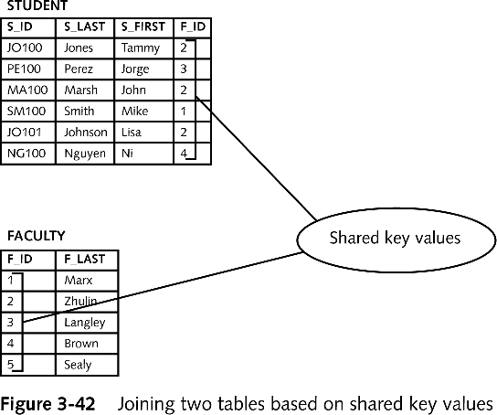
Inner Join
Simplest type of join
Also called: Equality join, Equijoin, Natural join
VALUES in one table equal to values in other table
Query design diagram helps get the query right

Slide 130
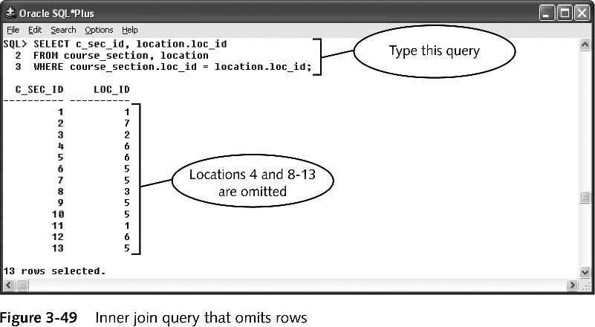
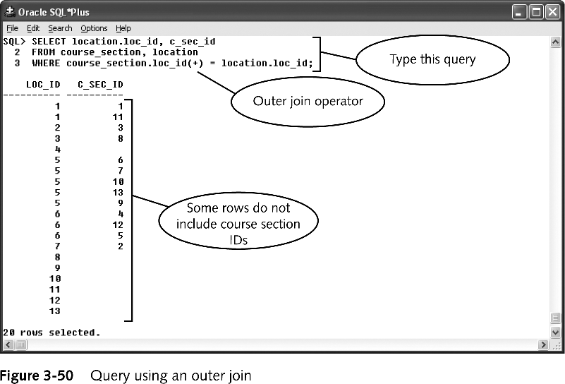
Outer join
Inner joins return row only if values exist in all joined tables
Outer joins return
all rows from one table (called inner table) and
only matching rows from second table (outer table)
Syntax: inner_table.join_col = outer_table.join_col(+)

Slide 131
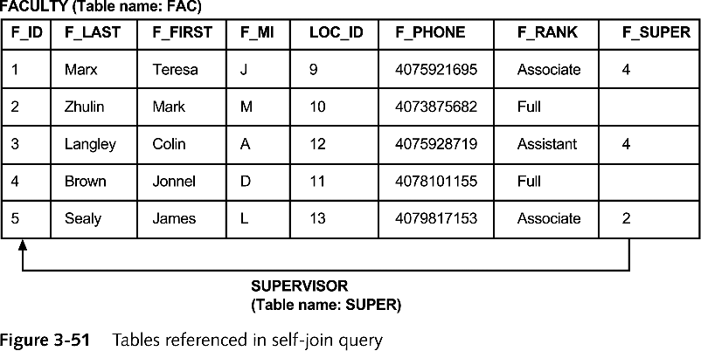
Self join
Query that joins table to itself
Must create table alias
Alternate name assigned to table in query’s FROM clause
Syntax: FROM table1 alias1, table1 alias2 …

Slide 132
Correlated sub-queries
If a condition in the WHERE-clause of a nested query references an attribute of a relation declared in the outer query, the two queries are said to be correlated
The result of a correlated nested query is different for each tuple (or combination of tuples) of the relation(s) the outer query
Example:-
SELECT E.FNAME, E.LNAME FROM EMPLOYEE AS E WHERE E.SSN IN (SELECT ESSN FROM DEPENDENT WHERE ESSN=E.SSN AND E.FNAME=DEPENDENT_NAME)

Slide 133
Correlated sub-queries
A query written with nested SELECT... FROM... WHERE... blocks and using the = or IN comparison operators can always be expressed as a single block query.
The first nested query, which is correlated, retrieves the project numbers on which the employee works, which is different for each employee tuple because of the correlation

Slide 134
Derived tables
Derived tables are the tables which are created on the fly with the help of the Select statement. It is different from the temporary table in the way that in case of temporary table, first we have to create a temporary table, insert the data into the table, select the data from the temporary table and then we have to drop the temporary table. But in case of derived table, SQL Server itself create and populate the table in the memory and we can directly use it. Also we don,t need to drop it. But it can only be referenced by the outer Select query who created it. Also since it is reside in the memory itself, it is faster then Temporary tables which are created in the temp database.

Slide 135
Syntax…
CREATE TABLE Sales
(
Salesperson VARCHAR(3),
Area CHAR(1),
Value MONEY
)
INSERT INTO Sales VALUES ('Bob', 'N', 100)
INSERT INTO Sales VALUES ('Bob', 'N', 125)
INSERT INTO Sales VALUES ('Sam', 'N', 120)
INSERT INTO Sales VALUES ('Jim', 'S', 120)
INSERT INTO Sales VALUES ('Tim', 'S', 130)

Slide 136
STORED PROCEDURES AND
USER DEFINED FUNCTIONS

Slide 137
CONTENT
Procedural extensions
If statement
WHILE statement
Local variables
Try and catch statement
Stored procedures
User defined sysytem
Insert and update statement
System catalog

Slide 138
INTRODUCTION TO PL\SQL
The SQL Procedural Language (SQL PL) is a language extension of SQL that consists of statements and language elements that can be used to implement procedural logic in SQL statements. SQL PL provides statements for declaring variables and condition handlers, assigning values to variables, and for implementing procedural logic.

Slide 139
ADVANTAGES OF PL/SQL
BLOCK STRUCTURE
PROCEDURAL LANGUAGE CAPABILITY
ERROR HANDLING
BETTER PERFORMANCE
TIGHT INTEGRATION WITH SQL
HIGHER PRODUCTIVITY
SECURITY
FULL PORTABILITY
PL/SQL DECLARATION

Slide 140
ARCHITECTURE OF PL/SQL
PL-SQL Architecture - Architecture of PL-SQL Architecture of PL/SQL: PL/SQL runtime system is a technology that has an engine which executes PL/SQL blocks and subprograms. An engine can be installed in the Oracle server or in an application development tool like as Reports and Forms.

Slide 141
PL/SQL BLOCK STRUCTURE
PL/SQL program units organize the code into blocks. A block without a name is known as an anonymous block. The anonymous block is the simplest unit in PL/SQL. It is called anonymous block because it is not saved in the Oracle database.
[DECLARE]
Declaration statements;
BEGIN
Execution statements;
[EXCEPTION]
Exception handling statements;
END;
/

Slide 142
PL/SQL CHARACTER SETS
IDENTIFIERS
LITERALS
NUMERIC LITERALS
CHARACTER LITERALS
STRING LITERALS
BOOLEAN LITERALS
DELIMITERS
COMMENTS

Slide 143
PL/SQL DATA TYPES
SCALER
COMPOSITE
REFERENCE
LARGE OBJECT

Slide 144
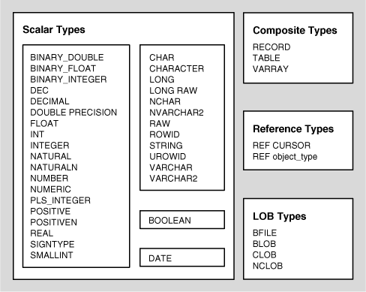
PL/SQL DATA TYPES

Slide 145
PL/SQL VARIABLES
PL/SQL variables must be declared in the declaration section or in a package as a global variable. When you declare a variable, PL/SQL allocates memory for the variable's value and the storage location is identified by the variable name.
The syntax for declaring a variable is −
variable_name [CONSTANT] datatype [NOT NULL] [:= | DEFAULT initial_value] Where, variable_name is a valid identifier in PL/SQL, datatype must be a valid PL/SQL data type or any user defined data type.
DECLARE :-
salary number(4);
dept varchar2(10)
NOT NULL := “HR Dept”;

Slide 146
LOCAL VARIABLE
In the SQL Server, I can define local variables like this.
declare @id number := 1000 select * from tbl_A where id = @id; select * from tbl_B where id = @id;

Slide 147
TRY AND CATCH STATEMENT
Implements error handling for Transact-SQL that is similar to the exception handling in the Microsoft Visual C# and Microsoft Visual C++ languages. A group of Transact-SQL statements can be enclosed in a TRY block. If an error occurs in the TRY block, control is passed to another group of statements that is enclosed in a CATCH block.
SYNTAX:-
BEGIN TRY
{ sql_statement | statement_block }
END TRY BEGIN CATCH
[ { sql_statement | statement_block } ] END CATCH [ ; ]

Slide 148
IF STATEMENT
IF THEN STATEMENT
IF (condition) THEN
(sequence_of_statements);
END IF;
IF THEN ELSE STATEMENT :-
IF (condition)THEN
(sequence_of_if_statements);
ELSE
( sequence_of_else_statemens);
END IF;

Slide 149
NESTED IF STATEMENT
IF(condition1)THEN -- executes when the condition 1 is true IF(condition2) THEN -- executes when the condition 2 is true sequence-of-statements; END IF; ELSE -- executes when the condition 1 is not true else-statements; END IF;
IF THEN ELSE IF STATEMENT:-
IF condition1 THEN
sequence_of_statements1
ELSIF condition2 THEN
sequence_of_statements2
ELSE
sequence_of_statements3
END IF;

Slide 150
WHILE LOOP STATEMENT
The WHILE LOOP statement runs one or more statements while a condition is TRUE. The WHILE LOOP statement ends when the condition becomes FALSE or NULL, when a statement inside the loop transfers control outside the loop, or when PL/SQL raises an exception
SYNTAX:-
WHILE condition LOOP
sequence_of_statements
END LOOP

Slide 151
STORED PROGRAMS
A stored procedure is a named set of PL/SQL statements designed to perform an action. Stored procedures are stored inside the database. They define a programming interface for the database rather than allowing the client application to interact with database objects directly.
CREATE [OR REPLACE] PROCEDURE <proc_name> [list of parameters] IS
Declaration section
BEGIN
Execution section
EXCEPTION
Exception section
END;

Slide 152
USER DEFINED FUNCTIONS
You can write user-defined functions in PL/SQL to provide functionality that is not available in SQL or SQL built-in functions. User-defined functions can appear in a SQL statement anywhere SQL functions can appear, that is, wherever an expression can occur.
For example, user-defined functions can be used in the following:
The select list of a SELECT statement
The condition of a WHERE clause
CONNECT BY, START WITH, ORDER BY, and GROUP BY clauses
The VALUES clause of an INSERT statement
The SET clause of an UPDATE statement

Slide 153
INSERT STATEMENT
INSERT statement adds one or more records to any single table in a relational database. The INSERT statement may also be used to add rows to the base table, view, partition, subpartition, or object table. It also supports additional extensions such as inserting records into many tables at once and conditional inserts
Syntax:
INSERT INTO <table_name>
(<column_name>)
VALUES
(<value>);

Slide 154
UPDATE STATEMENT
The SQL UPDATE statement is used to update existing records in the tables.
The syntax for the UPDATE statement when updating a table in SQL is:
UPDATE table
SET column1 = expression1,
column2 = expression2,
... [WHERE conditions];

Slide 155
DELETE STATEMENTS
The DELETE statement removes entire rows of data from a specified table or view
SYNTAX:-
DELETE FROM customers
WHERE last_name = 'Smith'

Slide 156
System Catalog
Catalog views return information that is used by the SQL Server Database Engine. We recommend that you use catalog views because they are the most general interface to the catalog metadata and provide the most efficient way to obtain, transform, and present customized forms of this information. All user-available catalog metadata is exposed through catalog views.

Slide 157
REFERENCE
www.expertsmind.com/topic/pl-sql-architecture/architecture-of-pl-sql-96313.aspx
www.plsqltutorial.com/plsql-block-structure
https://docs.oracle.com/.../appdev.111/b28370/fundamentals.htm
docs.oracle.com/cd/E18283_01/appdev.112/e17126/while_loop_statement.htm
www.plsqltutorial.com/plsql-if-statement
www.techonthenet.com › SQL

Slide 158
INDEXES ,VIEWS AND SECURITY

Slide 159
CONTENT
INDEXES
TYPES OF INDEX
CREATING AN INDEX
CREATION OF UNIQUE INDEX
GUIDELINES FOR USING INDEXES
VIEWS
ADVANTAGES AND DISADVANTAGES OF VIEW
DATABASE SECURITY
SQL GRANT COMMAND
SQL REVOKE COMMAND
PRIVILEGES AND ROLE
CREATING ROLES

Slide 160
INDXEXS
Index is an Oracle object that contains the value that exist in one or more columns in a table.
It used by DBMS engine to find a row in a table quickly.
It consist of a key value i.e a column in a row and the rowid.
The row id is the physical address of the row in the table.
It consist of the following format :- OOOOOFFFBBBBBBBRR
Where :-
1.OOOOO :- is a data object number that identifies the database object
2.FFF :-is a tablespace relative datafile number of database that
contains the row .
3.BBBBBBB :- represents data block that contain a row.
4.RRR :- is the row of the block.

Slide 161
TYPES OF INDEX
Unique index : They guarentee that no rows of a table have duplicate value in the columns that defines the index. i.e it enforce primary key and unique constraints.
Non –Unique index :- It does not restrict the duplicate column values from being stored in the table. It can improve the query performance.

Slide 162
CREATING AN INDEX
Duplicate values are allowed:
Syntax :- CREATE INDEX index_name ON table_name (column1, column2, ...);
The SQL statement below creates an index named "idx_lastname" on the "LastName" column in the "Persons" table:
CREATE INDEX idx_lastname ON Persons (LastName);

Slide 163
CREATION OF UNIQUE INDEX
The unique index does not allows duplicate values .
The syntax is :-
SQL>CREATE INDEX COM_EMP_UN_INDEX
ON EMP (ENAME); COMPOSITE INDEXES
The following SQL creates a UNIQUE constraint on the "ID"
column when the "Persons" table is created:
CREATE TABLE Persons ( ID int NOT NULL UNIQUE,
LastName varchar(255) NOT NULL, FirstName varchar(255), Age int );

Slide 164
GUIDELINE FOR USING INDEXES
Create indexes after inserting table data
Index the correct tables and columns
Order index columns for performance
Limit the number of indexes for each table
Drop indexes that are no longer needed
Understand deferred segment creation
Estimate index size and set storage parameters
Specify the tablespace for each index
Consider parallelizing index creation
Consider creating indexes with NOLOGGING
Understand when to use unusable or invisible indexes

Slide 165
VIEWS
A view is a virtual table based on the result-set of an SQL statement.
By virtual, we mean, the tables do not store any data of their own but display data stored in other tables.
In other words, VIEWS are nothing but SELECT Queries.
A view contains rows and columns, just like a real table. The fields in a view are fields from one or more real tables in the database.
You can add SQL functions, WHERE, and JOIN statements to a view and present the data as if the data were coming from one single table.
CREATE VIEW view_name AS SELECT column_name(s) FROM table_name WHERE condition

Slide 166
ADVANTAGES OF VIEW
Structure: Views allow particular groups of users to see only those sections of a database they need to as their roles require. Thus the actual database structure is concealed from users.
Security: A database administrator can grant users access permissions to a database through a limited set of views that contain the data the users need or are authorised to access.
Query execution: If a view consists of columns from several database tables, the view acts as a single table. This can help in retrieving data for queries and the presentation of data to users in (1) above.
Consistency: Views present a consistent, unchanged image of the database structure, even if underlying database tables are changed periodically.

Slide 167
DISADVANTAGES OF VIEW
When table is dropped or modified, view becomes inactive, it depends on the table objects.
Not all the time we can perform DML statements, as normally views are made for complex query and depends on more than one table. So there is more possibilities of violating your database constrains while performing DML statements.
As views are normally used for a complex static query, not all the times we can have same situation to use that static query. For example; If you are querying over view, then it looks like you save time , but if you are looking for few information from view, then you may face preformace degradation problem.

Slide 168
DATABASE SECURITY
Database security concerns the use of a broad range of information security controls to protect databases (potentially including the data, the database applications or stored functions, the database systems, the database servers and the associated network links) against compromises of their confidentiality, integrity and availability. It involves various types or categories of controls, such as technical, procedural/administrative and physical. Database security is a specialist topic within the broader realms of computer security, information security and risk management

Slide 169
SQL GRANT COMMAND
SQL GRANT is a command used to provide access or privileges on the database objects to the users.
The Syntax for the GRANT command is:
GRANT privilege_name ON object_name TO {user_name |PUBLIC |role_name} [WITH GRANT OPTION];

Slide 170
SQL REVOKE COMMAND
The REVOKE command removes user access rights or privileges to the database objects.
The Syntax for the REVOKE command is:
REVOKE privilege_name ON object_name FROM {user_name |PUBLIC |role_name}

Slide 171
PRIVILEGES
Privileges: Privileges defines the access rights provided to a user on a database object. There are two types of privileges.
1) System privileges - This allows the user to CREATE, ALTER, or DROP database objects. 2) Object privileges - This allows the user to EXECUTE, SELECT, INSERT, UPDATE, or DELETE data from database objects to which the privileges apply.

Slide 172
ROLES
Roles are a collection of privileges or access rights. When there are many users in a database it becomes difficult to grant or revoke privileges to users. Therefore, if you define roles, you can grant or revoke privileges to users, thereby automatically granting or revoking privileges. You can either create Roles or use the system roles pre-defined by oracle.

Slide 173
CREATING ROLES
The Syntax to create a role is:
CREATE ROLE role_name [IDENTIFIED BY password];
For Example: To create a role called "developer" with password as "pwd",the code will be as follows :-
CREATE ROLE testing [IDENTIFIED BY pwd];

Slide 174
REFERENCE
https://www.w3schools.com › sql_view
beginner-sql-tutorial.com › sql-grant-rev...

Slide 175
TRIGGER

Slide 176
Content
Introduction to triggers
Types of trigger
Creating triggers
Components of trigger
Using trigger
Database trigger
Server trigger

Slide 177
Introduction of Trigger
In a DBMS, a trigger is a SQL procedure that initiates an action (i.e., fires an action) when an event (INSERT, DELETE or UPDATE) occurs. Since triggers are event- driven specialized procedures, they are stored in and managed by the DBMS. A trigger cannot be called or executed; the DBMS automatically fires the trigger as a result of a data modification to the associated table. Triggers are used to maintain the referential integrity of data by changing the data in a systematic fashion.
Each trigger is attached to a single, specified table in the database.

Slide 178
PL/SQL Triggers Syntax
PL/SQL trigger define using CREATE TRIGGER statement:-
CREATE [OR REPLACE] TRIGGER trigger name
BEFORE | AFTER
[INSERT, UPDATE, DELETE [COLUMN NAME..] ON table name
DECLARE
[ declaration section
variable declarations;
constant declarations; ]
BEGIN
[ executable section PL/SQL execute/subprogram body ] EXCEPTION
[exception section PL/SQL Exception block ]
END;

Slide 179
Syntax Description
CREATE [OR REPLACE] TRIGGER trigger name: Create a trigger with the given name. If already have overwrite the existing trigger with defined same name.
BEFORE | AFTER : Indicates when the trigger get fire. BEFORE trigger execute before when statement execute before. AFTER trigger execute after the statement execute.
[INSERT, UPDATE, DELETE [COLUMN NAME..]: Determines the performing trigger event. You can define more then one triggering event separated by OR keyword.
ON table_name: Define the table name to performing trigger event.
FOR EACH ROW | FOR EACH STATEMENT: Trigger must fire when each row gets Affected (ROW Trigger). and fire only once when the entire sql statement is execute (STATEMENT Trigger).
WHEN Condition: Optional. Use only for row level trigger. Trigger fire when specified condition is satisfy.

Slide 180
Component of Trigger
Triggering SQL statement: SQL DML (INSERT, UPDATE and DELETE) statement that execute and implicitly called trigger to execute.
Trigger Action: When the triggering SQL statement is execute, trigger automatically call and PL/SQL trigger block execute.
Trigger Restriction: We can specify the condition inside trigger to when trigger is fire.

Slide 181
Type of Triggers
BEFORE Trigger: BEFORE trigger execute before the triggering DML statement (INSERT, UPDATE, DELETE) execute. Triggering SQL statement is may or may not execute, depending on the BEFORE trigger conditions block.
AFTER Trigger: AFTER trigger execute after the triggering DML statement (INSERT, UPDATE, DELETE) executed. Triggering SQL statement is execute as soon as followed by the code of trigger before performing Database operation.
ROW Trigger: ROW trigger fire for each and every record which are performing INSERT, UPDATE, DELETE from the database table. If row deleting is define as trigger event, when trigger file, deletes the five rows each times from the table.

Slide 182
Statement Trigger: Statement trigger fire only once for each statement. If row deleting is define as trigger event, when trigger file, deletes the five rows at once from the table.
Combination Trigger: Combination trigger are combination of two trigger type,
Before Statement Trigger: Trigger fire only once for each statement before the triggering DML statement.
Before Row Trigger : Trigger fire for each and every record before the triggering DML statement.
After Statement Trigger: Trigger fire only once for each statement after the triggering DML statement executing.
After Row Trigger: Trigger fire for each and every record after the triggering DML statement executing.

Slide 183
Creating a Trigger
We now require two triggers:
When a record is INSERTED into the blog table, we want to add a new entry into the audit table containing the blog ID and a type of ‘NEW’ (or ‘DELETE’ if it was deleted immediately).
When a record is UPDATED in the blog table, we want to add a new entry into the audit table containing the blog ID and a type of ‘EDIT’ or ‘DELETE’ if the deleted flag is set.

Slide 184
Using Triggers
1) Triggers supplement the standard capabilities of your database to provide a highly customized database management system. For example, you can use triggers to:
2) Automatically generate derived column values
3) Enforce referential integrity across nodes in a distributed database
4) Enforce complex business rules
5) Provide transparent event logging
6) Provide auditing
7) Maintain synchronous table replicates
8) Gather statistics on table access
9) Modify table data when DML statements are issued against views
10) Publish information about database events, user events, and SQL statements to subscribing applications
11) Restrict DML operations against a table to those issued during regular business hours
12) Enforce security authorizations
13) Prevent invalid transactions

Slide 185
DATABASE TRIGGER
Database trigger : Database trigger has been work on table like insert, update and delete record.
Important:-
Certain system stored procedures that perform DDL-like operations can also fire DDL triggers. Test your DDL triggers to determine their responses to system stored procedures that are run. For example, the CREATE TYPE statement and sp add type stored procedure will both fire a DDL trigger that is created on a CREATE_TYPE event. However, the sp rename stored procedure does not fire any DDL triggers.

Slide 186
SERVER TRIGGER
The SQL Server trigger is a special type of stored procedures that is automatically executed when an event occurs in a specific database server. SQL Server provides us with two main types of triggers: the DML Triggers and the DDL triggers. The DDL triggers will be fired in response to different Data Definition Language (DDL) events, such as executing CREATE, ALTER, DROP, GRANT, DENY, and REVOKE T-SQL statements. The DDL trigger can respond to the DDL actions by preventing these changes from affecting the database, perform another action in response to these DDL actions or recording these changes that are executed against the database.

Slide 187
Refrences
ps://way2tutorial.com/plsql/plsql_triggers.php
https://understandingrdbms.blogspot.com/2013/04/triggers.html
https:// www.sitepoint.com/how-to-create-mysql-triggers/

