Slide 1
Vehicle chassis
Introduction of Chassis Frame
Chassis frame is the basic frame work of the automobile. It supports all the parts of the automobile attached to it.
It is made of drop forged steel, carbon steel or aluminium alloy.
All the parts related to automobile like powerplant,transmission, steering, suspension, braking system,etc are attached to and supported by it only.

Slide 2
Chassis Operating Conditions:
The design of an automobile chassis requires prior understanding of the kind of conditions the chassis is likely to face on the road. The chassis generally experiences four major loading situations, that include,
vertical bending(symmetric)
longitudinal torsion(asymmetric vertical loads)
lateral bending, and
horizontal lozenging.
Vertical Bending. Considering a chassis frame is supported at its ends by the wheel axles and a weight equivalent to the vehicle’s equipment, passengers and luggage is concentrated
around the middle of its wheelbase, then the side-members are subjected to vertical bending causing them to sag in the central region.(figure next to longitudinal bending)
Longitudinal Torsion. When diagonally opposite front and rear road-wheels roll over bumps simultaneously, the two ends of the chassis are twisted in opposite directions so that both the side and the cross-members are subjected to longitudinal torsion (Fig. 21.2), which distorts the chassis.

Slide 3
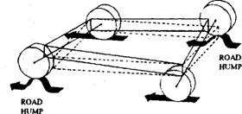
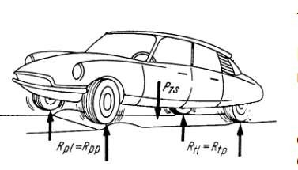
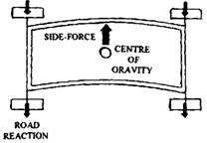
Fig. 21.2. Longitudinal torsion.
Lateral Bending. The chassis is exposed to lateral (side) force that may be due to the camber of the road, side wind, centrifugal force while turning a corner, or collision with some object. The adhesion reaction of the road-wheel tyres opposes these lateral forces. As a net result a bending moment (Fig. 21.3) acts on the chassis side members so that the chassis frame tends to bow in the direction of the force.
Fig. 21.3. Lateral bending.

Slide 4
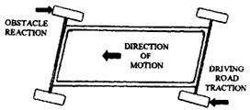
Horizontal Lozenging. A chassis frame if driven forward or backwards is continuously subjected to wheel impact with road obstacles such as pot- holes, road joints, surface humps, and curbs while other wheels produce the propelling thrust. These conditions cause the rectangular chassis frame to distort to a parallelogram shape, known as ‘lozenging’ (Fig. 21.4).
Fig. 21.4. Lozenging.

Slide 5
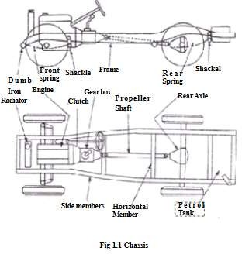
Chassis components

Slide 6
Types of car body:
Some of the important car body styles are as mentioned below.
1. Hatchback
  Sedan(saloon)
  MUV/SUV
  Coupe
  Convertible
  limousine
  Van
  Jeep
  Pickup vehicle

Slide 7
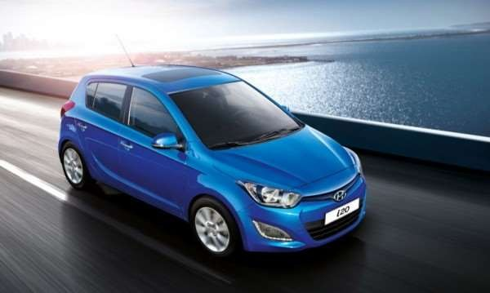
Hatchback

Slide 8
The small cars with 4 doors and a boot (dickey) door are classified under hatchback. Generally these are designed for comfortable seating of 4 passengers and small boot space for putting one or two bags. The size of hatchback varies depending upon design. It could be super mini, or a larger one. The design is same but interior size and luggage space varies.
In this type of vehicle the entire back gate can be lifted.

Slide 9
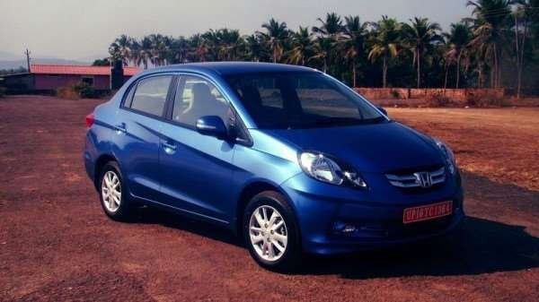
sedan

Slide 10
Sedans are the cars designed to for comfortable seating of 5 passengers. Sedans come with larger trunk sizes which can be used for carrying larger amount of luggage. The features of sedan includes larger overall dimensions i.e. length, width, height and wheel base. Many times the existing hatchback car design is itself used for sedan with boot space extended.

Slide 11
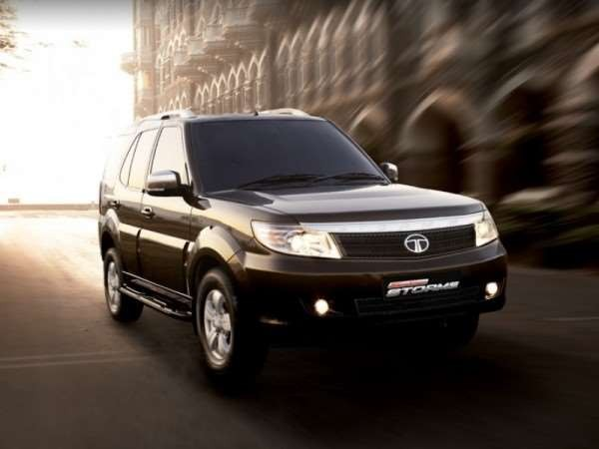
SUV/MUV

Slide 12
Although the MUV (Multi Utility Vehicle) and SUV (Sport Utility Vehicle) sport similar designs, the two are significantly different.
MUV vehicles are designed to create utility. There would be flexible seating options ranging from 7, 8, 9 and 10 so on. The body is built on chassis frame and can carry large amounts of luggage.
SUV are vehicles designed to use in all road conditions, ranging from highways to cross country roads.In this type, importance is given for all factors such as usage of advanced technology for engine, gearbox,
differential, 4WD option, interior space. SUV’s have features suited for long drives,good technology for suspensions, and so on.The main point about SUV is the importance given to fit and finish (both interior and exterior) and drive quality.

Slide 13
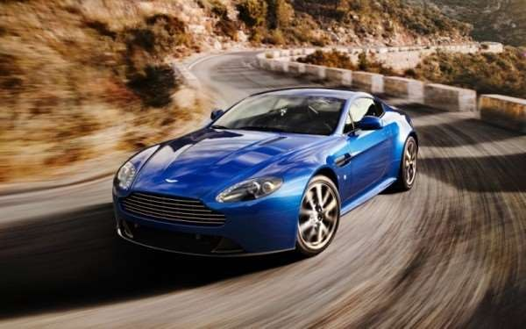
Coupe

Slide 14
Coupe is the name given to sedan cars with two doors only.The two doors are bit larger and though rear seat is available in some models, one can go to inside through sliding of front seats. Here main importance is given to styling, luxury and image. Coupe design is used mostly in European countries

Slide 15
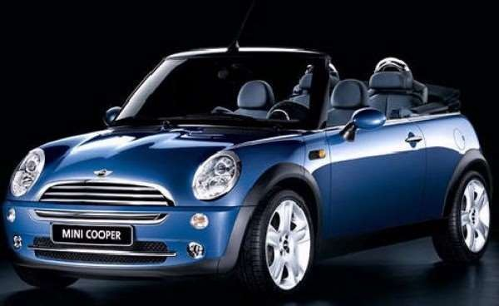
Convertible

Slide 16
Convertible cars are the cars whose roof line can be removed or refitted as required. Generally it’s available in high end luxury vehicles. Electro mechanical devices are used for step by step folding of the roof lines. In earlier vehicles leather material were used. In modern vehicles the metal roof lines with design of folding part by part and eventually rest on/in trunk part of the vehicle. Operating of a button is good enough for folding or putting back the roof linings.
Convertibles are more frequently used in cold countries wherein weather temperature is quite less and also roads have lesser dusty conditions.It’s purely a preferred choice for persons with passion of using stylish cars and the feel of air in hair when driving vehicle.

Slide 17
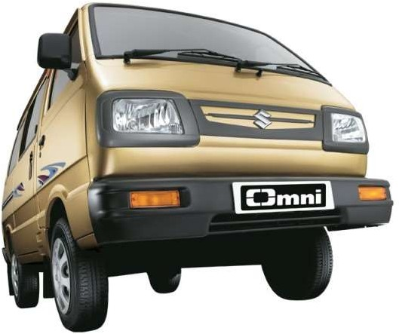
VAN

Slide 18
Van is the name given to cars with main perspective of flexibility in utilizing the interior space. It has options of varying number of seats and hence luggage space .Best Example are the Maruti Suzuki Omni, Eeco.
There is difference in the vehicles (particularly Van) used purely for commercial purpose and for the one used for passenger purpose.

Slide 19
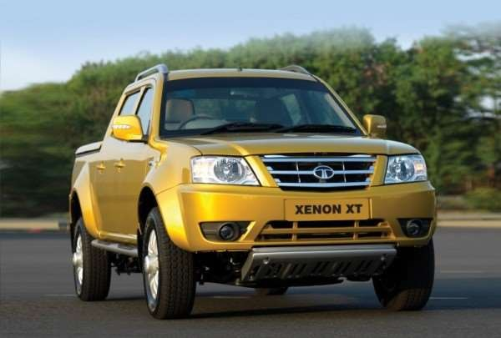
Pick up vehicle.

Slide 20
Pick up vehicle (Pick up Van) is the term used for the MUV with separate space for luggage.
There would be spacious interiors for comfortable seating of 5 passengers and separate luggage space available behind the passenger cabin.The dimensions of vehicle would be larger and body is built on chassis frame so that load carry capacity can be considerably large. Generally it could be around 800Kg.

Slide 21
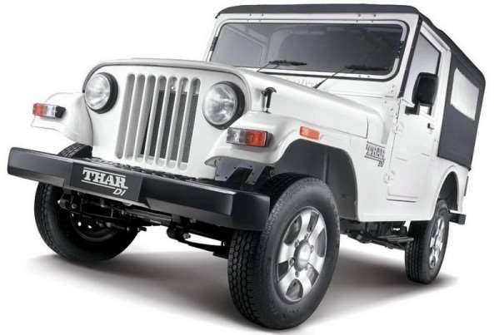
Jeep

Slide 22
Jeep is a particular type of vehicle similar to that of MUV but there is option for hard top or soft top.
This type of vehicle has good combination of utility like that of a sports car and cost like that of a MUV and hence can be best suitable one for cross country usage and taking out for adventure drive in forests.

Slide 23
CLASSIFICATION OF BUSES
Passenger carrying buses are classifies based on:
1)Distance traveled by the vehicle
2)Capacity of the vehicle
3)Shape and Style of the vehicle

Slide 24
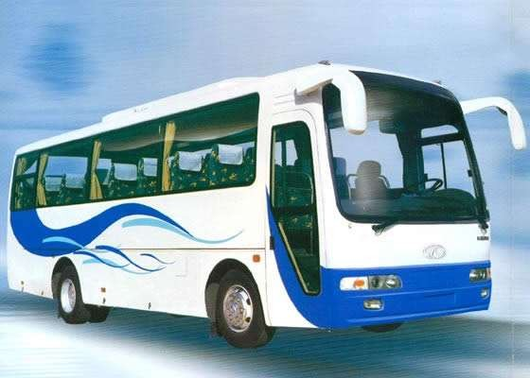
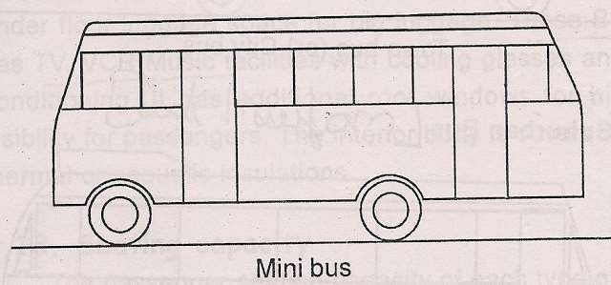
1.Distance traveled by the vehicle:
1. MINI BUS:

Slide 25
It should have a seating capacity upto 25.
It built on light duty truck chassis.
It has front mounted engine and rear axle drive.
It has soft and comfort suspension.
It has reasonably comfortable seat.
It has fairly small entry platforms.

Slide 26
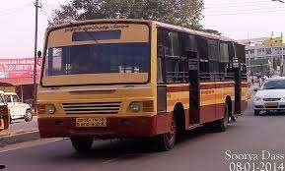
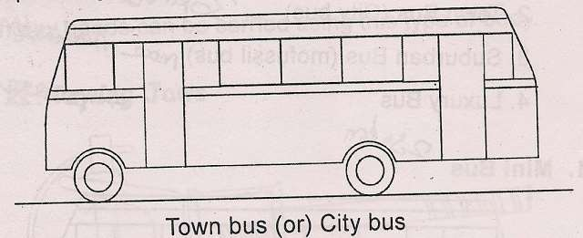
2.Town bus

Slide 27
These buses are used for a short distance of about 20-30kms.
They are provided with large number of standing places, wide doors with large entry and exit platform and hard seats covered with durable plastic materials.
Due to short intervals between stops in local traffic, such busses are provided with wide entrance and exit doors with low steps entry and exit platform.

Slide 28
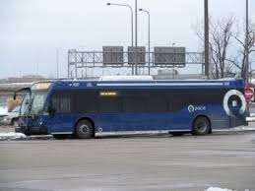
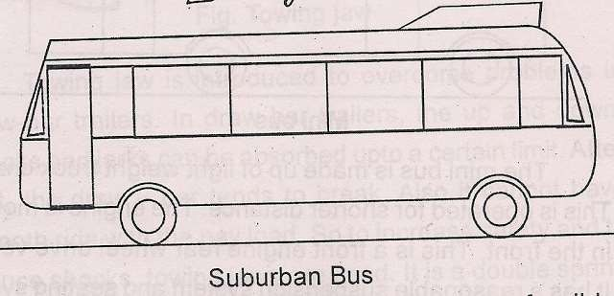
3.Suburban bus

Slide 29
These buses are used for a distance of about 40 to 50 kms. They usually have reasonably comfortable seats.
Seating capacity of 38 persons with roof rack for hand luggage

Slide 30
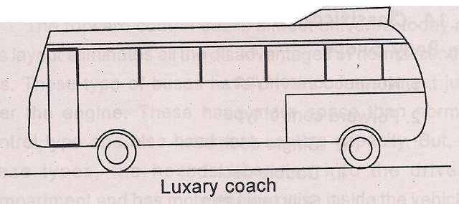
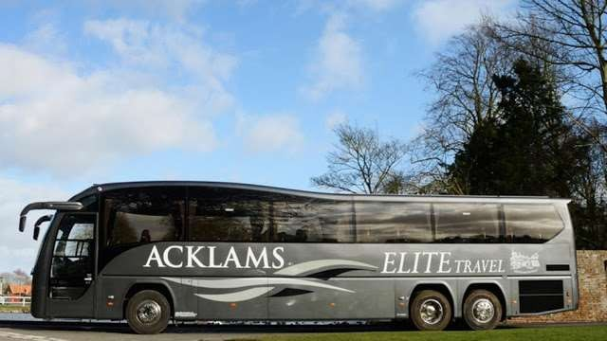
5.Touring Coaches /Luxury coach

Slide 31
For longer distance touring coaches, very comfortable reclining seats are used.
Toilets, air conditioners, TV,VCR,etc are provided.
Additional windows in the roof are used to improve visibility for the passengers.
Thermal and acoustic insulation is usually elaborate and spacious luggage compartments are provided under the floor and on the roof .

Slide 32
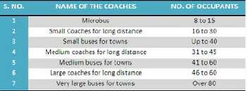
2.Based on the capacity of the vehicle

Slide 33
3.Based on Shape and Style of the vehicle
Classic type
Single Decker
Double Decker
Split‐level bus
Two‐level single Decker
Articulated bus

Slide 34

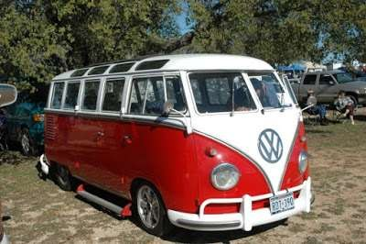
1.Classic type

Slide 35
•
The Classic or normal control bus has the engine in front of the passenger carrying compartment.
This design, which was almost universal at one time, has practically disappeared and is mainly of historical interest.
Low ratio of useful length to overall length.
It also has a high tare weight and poor aerodynamic shape.
Now a days it is mainly use for school buses.

Slide 36

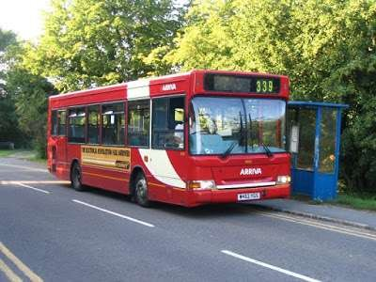
2.Single Decker

Slide 37
The full‐length bodywork, i.e. single deck bus or coach is almost universal today as this layout eliminates all the disadvantages of classic type.
In this busses tahe engine is mounted either inside or below the drivers cab, enabling additional length available for more seats and better angle of vision.
Has seating capacity of 52.

Slide 38

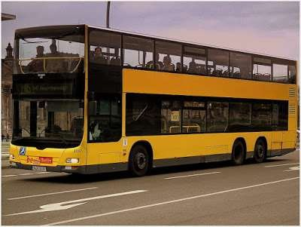
3.Double Decker

Slide 39
These buses have a greater number of seats for a given overall length than a single Decker.
stability is not so high as for the single Decker.
Has capacity of 65-75.
It may have upper deck open for tourists.
Engine is mounted on rear giving better visibility for passenger and driver.

Slide 40

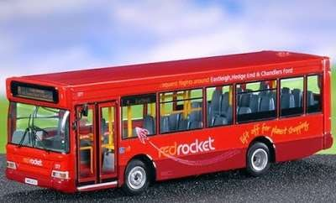
5.Two‐level single Decker

Slide 41
Two‐level single Decker has been used for luxury coaches.
This layout provides good forward visibility for all passengers, good luggage space and easy installation of an under‐floor or rear engine.
Again this type is only made for special orders, as it is not easy to make derivations from the same body shell.

Slide 42

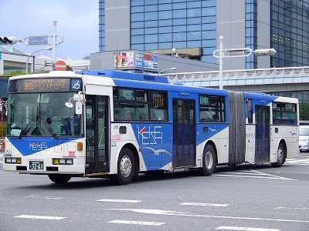
6.Articulated bus

Slide 43
Bodies for very large coaches or in particular, city buses are often made in two parts because of axle load limitations. The rear portion is articulated to the main vehicle by a covered pivot allowing easy access between the two sections.
A bi‐articulated bus or double articulated bus is an extension of an articulated bus in that it has three passenger compartment sections instead of two.
This also involves the addition of an extra axle. Due to the extended length, bi‐articulated buses tend to be used on high frequency core routes or bus rapid transit schemes rather than conventional bus routes.
Mainly uses for in-city operation.

Slide 44
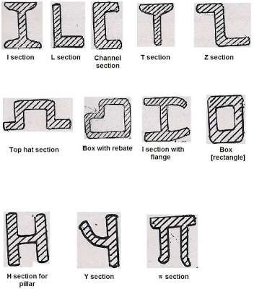
TYPES OF METAL SECTION USED:

Slide 45
a. Channel Section -Good resistance to bending
b. Tabular Section-Good resistance to Torsion
c. Box Section-Good resistance to both Bending and Torsion

Slide 46
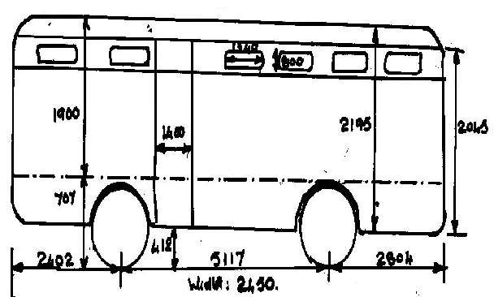
Bus body Regulations:

Slide 47
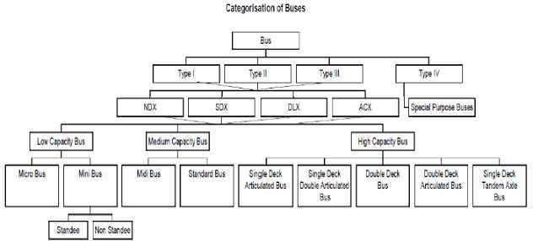

Slide 48
Buses are categorized into four Types, namely,
  Type I
  Type II
  Type III
  Type IV
Type I
•
Vehicles are the medium and high capacity vehicles designed and constructed for urban and sub urban / city transport with area for standing passengers.
Type II
Vehicles are those designed and constructed for inter-urban/inter-city transport without specified area for standing passengers
Type III
•
Vehicles are those designed and constructed for long distance passenger transport, exclusively designed for comfort of seated passengers and not intended for carrying standing passengers.
Type IV
‘Type IV’ Vehicles are those designed and constructed for special purpose use such as the following :-
•
(1) School Bus: means vehicles designed and constructed specially for schools, college, and other educational Institutions.
•
(2) Sleeper Coaches: means vehicles designed and constructed specially berth to accommodate sleeping passengers.
•
(3) Tourist Bus: means vehicles designed and constructed for the purpose of transportation of passengers as tourists and may be
classified in any one Type of comfort levels.

Slide 49
•
Non Deluxe Bus(NDX) means bus designed for basic minimum comfort level.
Semi Deluxe Bus(SDX) means a bus designed for a slightly higher comfort level and with provision for ergonomically designed seats.
Deluxe Bus(DLX) means a bus designed for a high comfort level and individual seats and adjustable seat backs, improved ventilation and pleasing interiors.
A.C. Deluxe Bus(ACX) means a Deluxe Bus which is air conditioned.

Slide 50
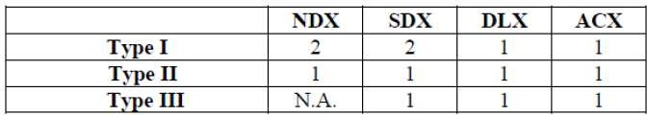
Number of Service Doors

Slide 51
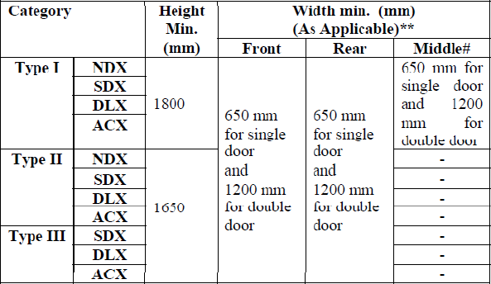
Minimum dimensions of Service Doors

Slide 52
Window:
The window panes shall be of sliding type for all buses except ACX buses.
However, in ACX buses the provision for adequate ventilation in case of A.C. failure shall be made.
The minimum width of the window aperture (clear vision zone) shall be 550 mm.
The minimum height of the sliding part of the window aperture (clear vision zone) shall be 550mm

Slide 53
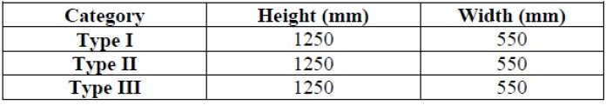
Emergency Exits:
At least one emergency exit shall be situated on the opposite side of the service door.
In case of more than one emergency exit, one of the emergency exit shall be situated in the front half of the vehicle, opposite to the service door and the second emergency exit shall be either on the rear half or at the rear side of the bus.

Slide 54
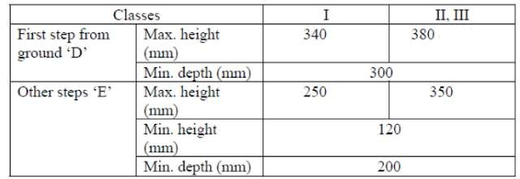
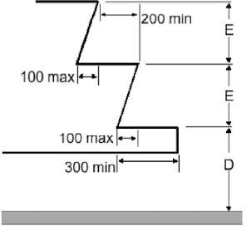
Steps:

Slide 55
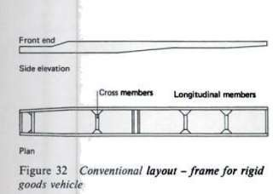
CONVENTIONAL TYPE CONSTRUCTION:

Slide 56
(It also called as “Separate body and chassis type”, “Orthodox type”)
The body and chassis will be as separate unit.
Bolts are used to join the body and chassis together.
The separate part of body will be placed over the top of the chassis.
A rubber block will be placed in between these two parts to avoid the vibration.
The conventional type building involves in building up of a ladder type frame with two long side members interconnected by cross members at intervals.
The units like engine, gear box, radiator, axles, steering wheel, fuel tank are mounted on the frame.
The whole body and passenger load is transmitted to the chassis by means of spring.
Chassis should be built strong so that it can withstand the weight of the body.
The frame sections are generally, used
a. Channel Section - Good resistance to bending
b. Tabular Section - Good resistance to Torsion
c. Box Section - Good resistance to both bending and Torsion

Slide 57
The basic under body structure is fabricated only thin mild steel cold rolled channel sections
It is fully galvanized for corrosion protection
It is provided with cross members and out riggers at specified intervals.
The pillar and roof shocks are made of sheet steel.
Pillars are bolted to the sole bar of the under structure.
The roof sticks are connected to the pillars by stiff pressed steel corner brackets and joined by solid rivets.
All the inner panels and wheel arch truss panels are sheet steel and solid steel riveted to the pillars.
All the outer panels and roof panels are pop riveted.

Slide 58
Advantage:
1.This is used in heavy vehicle. 2.This is of simple construction.
3.The change of designing and the alteration of frame length is easy. 4.Servicing is easy in case of any damage.
5.There is no need for more expenditure for preventing corrosion.
Disadvantage:
1.The weight of the frame is more, due to this the vehicle speed is decreased. More fuel is also required.
2.Since the floor height is more, the centre of gravity from the ground will also be more. Due to this, the stability will be decreased.

Slide 59
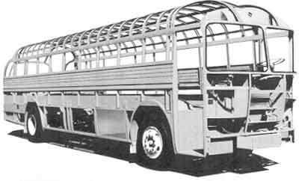
CONSTRUCTION OF INTEGRAL BUS BODY(MONOCOQUE / UNIBODY) :

Slide 60
Monocoque, meaning 'single shell' in French, is a construction technique that
utilizes the external skin to support some or most of the load. The technique may also be called structural skin or stressed skin.
The semi-monocoque is a hybrid of a mutually reinforcing tensile shell and compressive structure.
Unitary body / unit body - uses a system of box sections,bulkheads and tubes to
provide most of the strength of the vehicle,to which the stressed skin adds relatively little strength or stiffness.
In integral bus construction, a base structure is formed with 4 long Side members, cross members, outriggers and wheel arch supports.
Units like engine , gear box, axles etc are mounted on the flexible Under structure,
which is fabricated by welding.
These under structures are painted with suitable colors to prevent corrosion .
The body pillars which are ring frames are attached to the two extreme Side members called sole bars by bolting.
The panelling is done as per specifications to give good integral Structure.
The under and body structure act as a single structure to carry the Load.Thus for a
given load the integral structure will withstand more stress which indicates that every member of the structure is sharing the load.
•

Slide 61
DESIGN OF INTEGRAL BUS:
Chassis under structure
Unit weights like engine, gear box, radiator,steering box, batteries and fuel tank acting as point loads at the mounting points.
Weight of under stucture considered as uniformly distributed load.
Considering the vertical and lateral bending,moment is calculated
and a section required to carry the weights is decided allowing for a reservefactor depending on the road conditions.
Chassis body structure
Body weight considered as uniformly distributed load.
Payload considered as uniformly distributed load
Considering bending ,torsion and combination of both, the body
structure is designed allowing for a reserve factor depending in the road conditions.

Slide 62
Advantages:
•
  Light in weight compared with conventional type of body construction. so fuel consumption is
less.
  Easy entry/ exit and lower floor height is to be achieved.
  Greater strength.
  Free from squeaks and rattles caused by the working of bolted joints which are absent in this
construction.
  Reduction in heat in the driver and passenger area.
  Low noise and vibration level.
  Lowered wind screen level and better visibility for driver.
  Assembling of component is easy. 9.Mainly this type is used in car construction.
•
Disadvantages:
•
  when a car is involved in an accident, it is more expensive to repair the large panel sections.
  There is a greater liability of injury to the driver.
  It is more expensive to introduce changes in body styling to keep abreast of the times.
  Initial cost is more.
  Thick gauge material should be used. 6.More money is required to avoid corrosion.

Slide 63
http://srmncrautovbe.blogspot.in/2015/09/bus-body.html

Slide 64
Commercial vehicle
A commercial vehicle is any type of motor vehicle used for transporting goods or paid passengers.

Slide 65
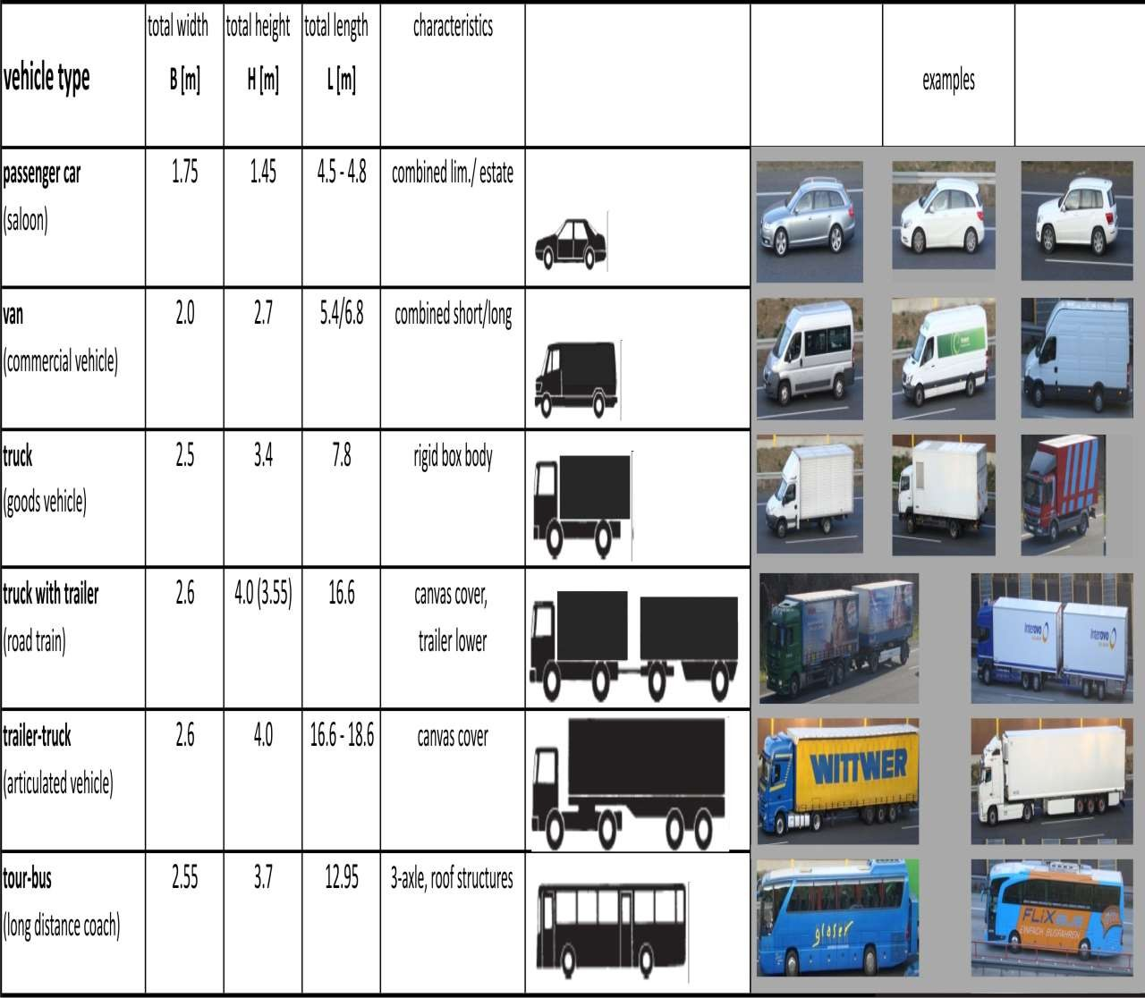

Slide 66
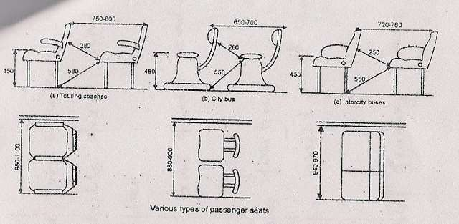
Seat design for ride comfort:(passenger)

Slide 67
If the seat is comfortable, the journey may be a pleasure trip ,But it will be a trouble some, tiring, agony, if the seat is uncomfortable.
The design of seat is designed to the structure of man.
Passenger seat is designed for comfort and also described according to distance between the consecutive seats.
Seats are manufactured by the materials a)Natural rubber latex
b)Cold – cure polyester (or) urethane c)Hot – cure foams (or) chip forms.
In passenger seat, the seating angle ranges from 50 and 100
In push back seating, the seating angle is included to 600

Slide 68
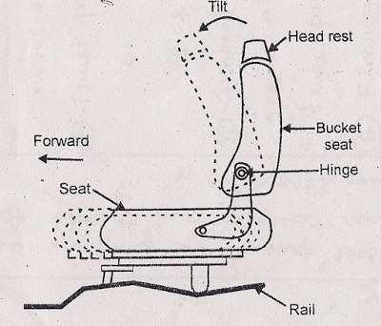

Slide 69
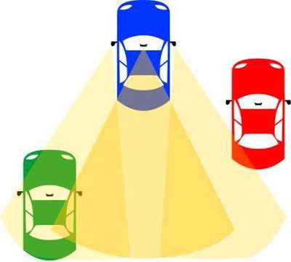
DRIVER'S VISIBILITY:

Slide 70
In transport, driver visibility is the maximum distance at which the driver of a vehicle can see and identify prominent objects around the vehicle. Visibility is primarily determined by weather conditions and by a vehicle's design.
The parts of a vehicle that influence visibility include the windshield, the dashboard and the pillars.Good driver visibility is essential to safe road traffic.Blind spots may occur in the front of the driver when the A-pillar (also called the windshield pillar), side-view mirror, and interior rear-view mirror block a driver's view of the road. Behind the driver, there are additional pillars, headrests, passengers, and cargo,that may reduce visibility.
A blind spot in a vehicle are areas around the vehicle that cannot be directly observed
under existing circumstances. Blind spots exist in a wide range of vehicles: cars,
trucks, motorboats and aircraft.

Slide 71
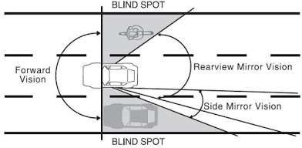

Slide 72
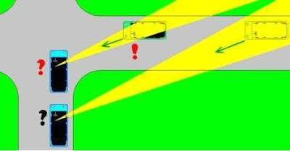
1. Forward visibility:

Slide 73
A-pillar blind spot
This diagram shows the blocked view in a horizontal-plane in front of the driver. The
front-end blind spots caused by this can create problems in traffic
situations, such as in
roundabouts, intersections, and road crossings. Front-end blind spots are influenced by the following design criteria:
Distance between the driver and the pillar
Thickness of the pillar
The angle of the pillar in a vertical plane side view
The angle of the pillar in a vertical plane front view
the form of the pillar straight or arc-form
Angle of the windshield
Height of the driver in relation to the dashboard
Speed of the opposite car

Slide 74
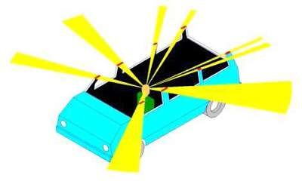
1.Effects of A-pillar angle on visibility :
Most passenger cars have a diagonal pillar as shown in this side view. The angle between the horizon and A-pillar is approximately 40 degrees with a straight pillar that is not too thick. This gives the car a strong, aerodynamic body with an adequately-sized front door. vertical A-pillar having small blind spots
40° angle A-pillar bar blind spots

Slide 75
1.1 Panoramic windshield:
The sides of a panoramic windshield are curved, which makes it possible to design vertical A-pillars that give the driver maximum forward visibility.
However, it is impossible to design an aerodynamic small car with a
vertical A-pillar because the more vertical the A-pillar is, the less space the door opening has, and the greater frontal area and coefficient of drag the vehicle will have.
some modern car designs have an extremely flat A-pillar angle with the horizon. For example, the Pontiac Firebird and Chevrolet Camaro from 1993-2002 had a windshield angle of 68° with the vertical, which equals just 22° with the horizon.A flatter A-pillar's advantages include reducing the overall drag coefficient and making the car body stronger in a frontal collision, at the expense of reducing driver visibility in a 180° field of view from left to right.

Slide 76
1. 2 Other disadvantages of a flat windshield angle
  Other traffic can not see the driver through the reflection if the driver can see them.
  The heater needs more time to heat the bigger window surface.
  The flat windshield angle does not let snow slide off easily.
  The driver cannot reach the whole flat window to clean it easily.

Slide 77
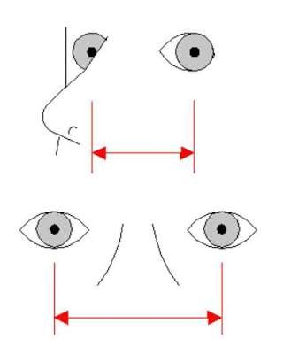
2. Height of the driver:
Turning your head reduces blind spot

Slide 78
Driver height can also affect visibility. An A-pillar that is split up and haves a small triangle window (Front Quarter glass) can give a short driver visibility problems.
Some cars the windshield is fillet with the roofline with a big radius. A fillet round A-pillar can give a tall driver visibility problems.Also sometimes the A-pillar can block the driver from seeing motorcyclists.
Also the B-pillar (car) can block the vision of a tall driver in small 4 door cars.
A driver may reduce the size of a blind spot or eliminate it completely by turning their head in the direction of the obstruction. This allows the driver to see better around the obstruction and allows the driver better depth perception

Slide 79
6. Rear-view mirror blind spots:
A vehicular blind spot is the area of the road that while driving cannot be seen when looking forward or through either the rear-view or side mirrors. Blind spots can be checked by turning one's head briefly, eliminated by reducing overlap between side and rear-view mirrors, or reduced by adding other mirrors with larger fields-of-view.
Detection of vehicles or other objects in blind spots may also be aided by systems such as video cameras or distance sensors, though these are uncommon or expensive options in automobiles generally sold to the public.

Slide 80
Construction of tipper body and tanker body:
TIPPER BODY:
A tipper body is attached to a rigid cab chassis and is used to carry a wide range of bulk products, such as gravel, sand and grain.
It is hinged at the rear which allows the front of the truck bed to be raised and the contents set down behind / side the truck.

Slide 81
CLASSIFICATION:
Based on type of tipping method
•Hydraulic
  Electric
Based on location of tipping mechanism
  Front end tipping
  Under body tipping
Based on direction of unloading
Single way
Three way

Slide 82
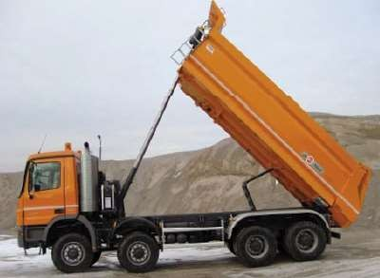
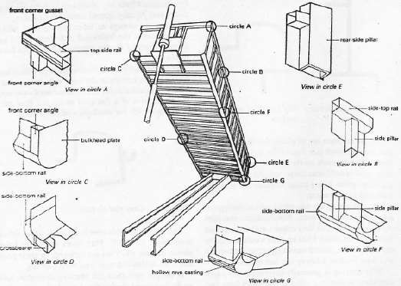
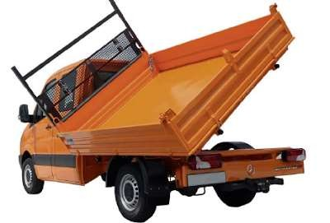
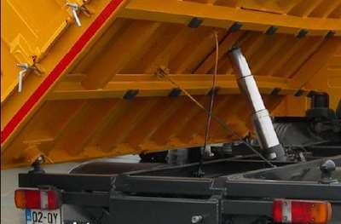

Slide 83
Tanker body:
USES OF TANKER BODY:
Used to transport goods like,detergent,varnish,edible oil,resins,fat,sugar in solution,liquid gaseous,fuel, oil, milk and water in bulk.
CLASSIFICATION OF TANKER BODY:
1.According to the type of liquid carrying:
  water tank body
  Fuel tank body
  Chemical liquids tank body
•
2.According to the shape of the tanker body:
Circular (round) cross section
Elliptical cross section
3.According to bulkheads:
  Baffled tanks
  Un baffled tanks (smooth bore tanks)

Slide 84
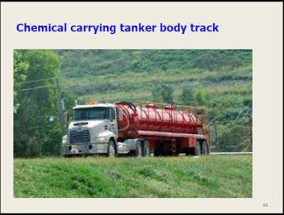

FUEL TANKS:
CHEMICAL LIQUIDS TANK BODY:

Slide 85
It is constructed in such a way to safely carry
different kinds of fuel to and from its
destination.
Some fuel tank body are used to transport
different grades of fuel to and from the gasoline station can be
chemical liquid tank truck is designed to carry corrosive, hazardous chemical liquids .
It is mainly composed of a chassis, tank body,discharge system, as well as some protective devices.
The tank can be constructed of carbon steel,stainless steel, aluminum alloy, or other materials,according to the specific properties of the transporting medium.
Some tank trucks can carry a variety of products at once due to their internal divisions in their tank,allowing for an increased number of delivery options
•
•
•
insulated or non-insulated,
pressurized or non-pressurized,
single or multiple compartments.
Some of the materials used to build these
fuel tanks include aluminum, fiberglass
reinforced plastic or FRP, stainless steel, and
carbon steel.
Insulated tank is used to Minimize fuel
temperature increases inside the tank, reducing fuel loss due to evaporation.
The fuel tank body that carries these
flammable gases is often pressurized and
can carry around 1,000 to 3,000 gallons of this fuel at one time.
Some fuel tanks can be compartmentalized
to carry 2, 3,4, or 5 different kinds of fuel at one time in one cylindrical containment unit.

Slide 86
Dimensions of driver’s seat:
The following points must have in mind when planning the driver’s seating position
The most comfortable position of the body is achieved when the bulk of the weight of the seated person is taken by the ischial bones.
The seat cushions should be fairly rigid and must have sufficient shock absorbing
qualities to prevent resonance of any springs that may be incorporated.
A good back-rest relieves the neck and shoulder muscles.
The angle between the seat and back-rest must be obtuse.
Armrests reduce tiredness.

Slide 87
Drivers cab design:
•
Forward control cab
Normal control cab
long distance cab
The design of the cab should ensure a degree of comfort for the group directly
related to the duration of the work inside it, modern cabs in trucks are having
comfortable as passenger cars.

Slide 88

Normal control:
In Normal control vehicle, engine is located in front of the driver’s cab to give more cab space, less noise, heat and ease entry and exit.

Slide 89

Forward control:
•
In forward control vehicle, engine is located either at the side or below the driver’s cab
This type has its cab built over the engine and has the advantage of additional length available for the payload and a better angle of vision.
Its disadvantages include less cab space for crew and engine maintenance can be more difficult unless specialized equipment is available or the cab is designed to tilt forward.
A variation to forward control aimed at giving ease of entry and exit for door to door delivery work and more space for the crew is the semiforward control type.

Slide 90


Slide 91


Slide 92


Slide 93


Slide 94


Slide 95


