Slide 1
WELCOME TO
POWER POINT PRESENTATION OF
APPLIED MECHANICS

Slide 2
Mechanics
The branch of science which deals with the forces and their effects on the bodies on which they act is called mechanics
Applied Mechanics
Applied mechanics also known as engineering mechanics is the branch of engineering which deals with the laws of mechanics as applied to the solution of engineering problems.
Application of applied mechanics
Some of the important practical applications of the principals and laws of mechanics are given below:
The motion of vehicles such as trains, buses etc.
The design of building and forces on columns and walls.

Slide 3
Branch of applied mechanics
The subject of applied mechanics is broadly divided into the following two branches:
Statics: The branch of applied mechanics which deals with the forces and their effects while acting upon bodies which are at rest is called statics.
Dynamics: The branch of applied mechanics which deals with the forces and their effects while acting upon bodies which are in motion is called dynamics.
It is further divided into two types:
Kinetics: The branch of dynamics which deals with the relationship between motion of bodies and forces causing motion is called kinetics.
Kinematics: The branch of dynamics which deals with motion of bodies without considering the forces which cause motion is called kinematics.

Slide 4
Physical Quantity
Any quantity which can be measured is called physical quantity. There are two types of physical quantities:
Fundamental or basic quantities: The mutually independent quantities are called fundamental or basic quantities.
Derived Quantities: The quantities which can be expressed in terms of fundamental or basic quantities are called derived quantities e.g.
•
•
Velocity = Displacement/ Time = Length/Time Linear momentum = Mass x velocity
Mass x Length/ Time

Slide 5
Fundamental or Basic Units
Quantity | Unit
Mass | kilogram(Kg)
Length | metre(m)
Time | Second(s)
Electric current | Ampere(A)
Absolute temperature | Kelvin(K)
Amount of substance | Mole(mol.)
Luminous intensity | Candela(cd)

Slide 6
SYSTEMS OF UNITS
There are four systems of units recognized universally:
C.G.S. Systems: In this system, the units of length, mass and time are centimetre, gram and second respectively.
F.P.S. Systems: In this system, the units of length, mass and time are foot, pound and second respectively.
M.K.S. Systems: In this system, the units of length, mass and time are metre, kilogram and second respectively.
S.I. Systems: In this systems, the units of length, mass and time are metre(m), kilogram(kg) and second(s) respectively. The S.I. units of various derived units are as under:

Slide 7
Rigid Body
A rigid body may be defined as a body which does not changes in shape and size under the effect of forces acting on it. In fact , no body is perfectly rigid. Every body when acted upon by external forces will undergo certain changes.
Scalar and vector quantities
Scalar quantities have only magnitude but no direction. e.g. mass, length, density, work, pressure, heat, current etc.
Vector quantities have both magnitude as well as direction.
E.g. velocity, acceleration, moment, impulse, force etc.

Slide 8
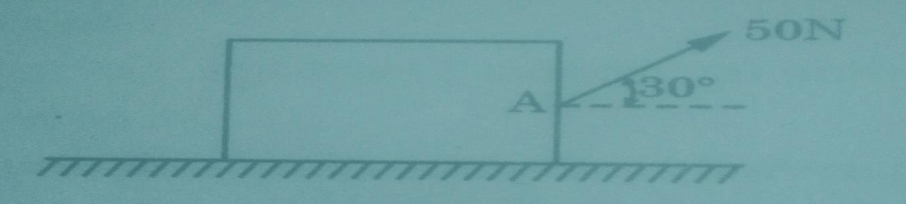
Unit - 2
Force
Thus force may be defined as a push or pull which either changes or tend to change the state of rest or of uniform motion of a body. Force is a vector quantity.
Characteristics of force
The followings are the characteristics of a force:
Magnitude: The quantity of a force is called its magnitude such as 50 N, 80 N, 25 kg etc.
Direction: The direction of a force is the direction of the line along which
it acts.
Nature of the force or sense: Nature of the force means whether the force is a push or a pull at the point of application.

Slide 9
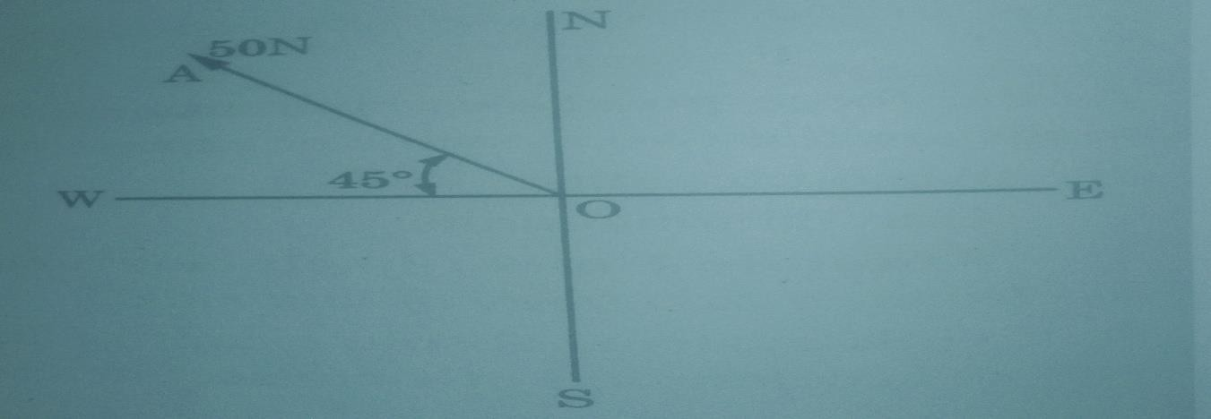
Effects of a force
A force acting on body may have the following effects on the body:
It may change the state of rest or of uniform motion of a body.
It may change the direction of motion of a moving body.
It may change the shape internal stresses in the body.
It may produce internal stresses in the body.
Representation of a force
There are two different methods of representing a force:
1. Vector representation: In this method, a force is graphically represented by a straight line drawn parallel to the line of action of force on any suitable scale.

Slide 10
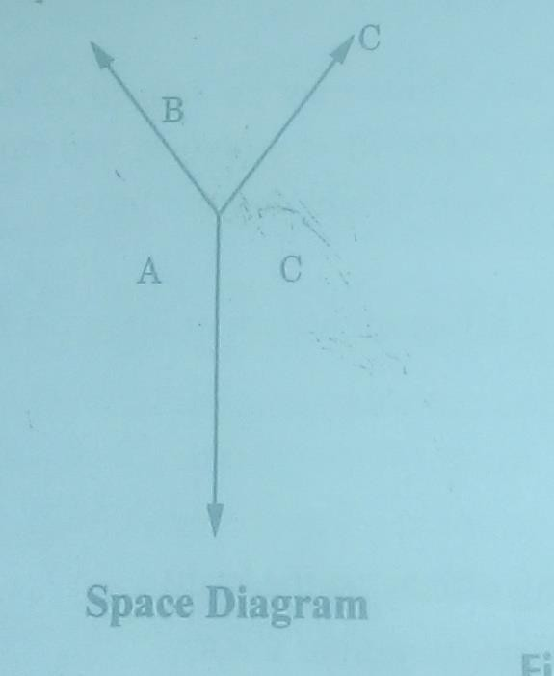
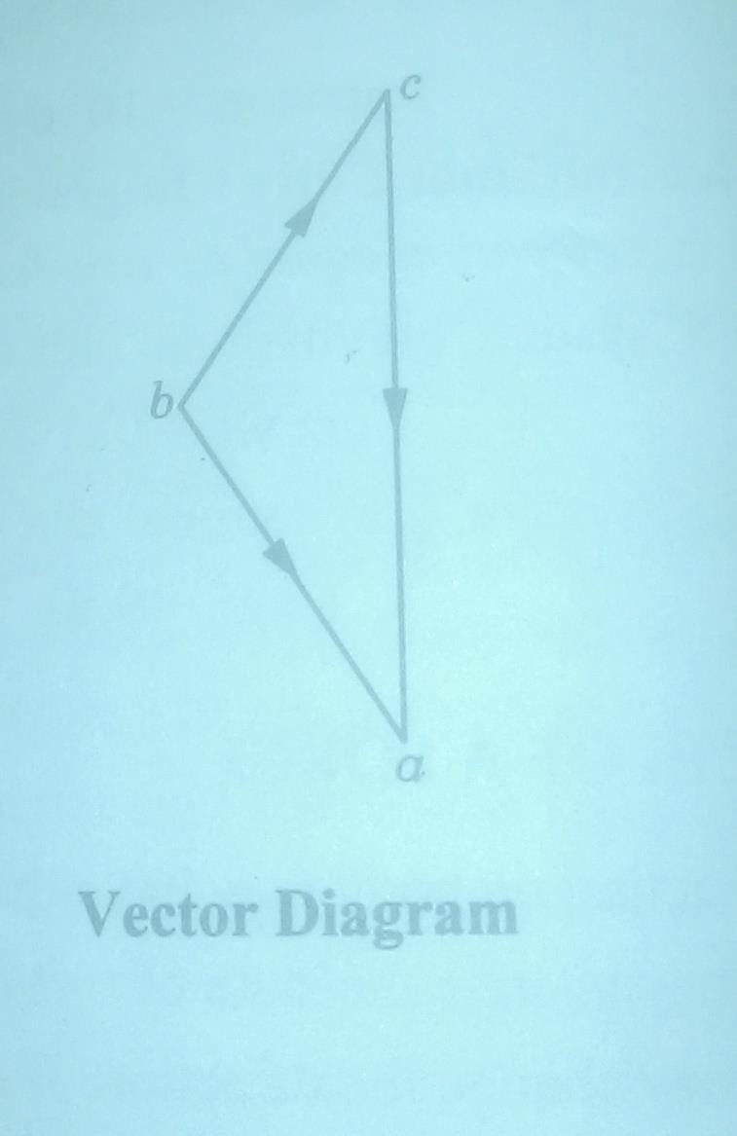
2. Bow’s Notation: Bow’s notation is a method of designation a force by writing two capital letters on either side of the line of action of force. The marking of capital letters can be done either in clockwise or anti-clockwise direction.

Slide 11
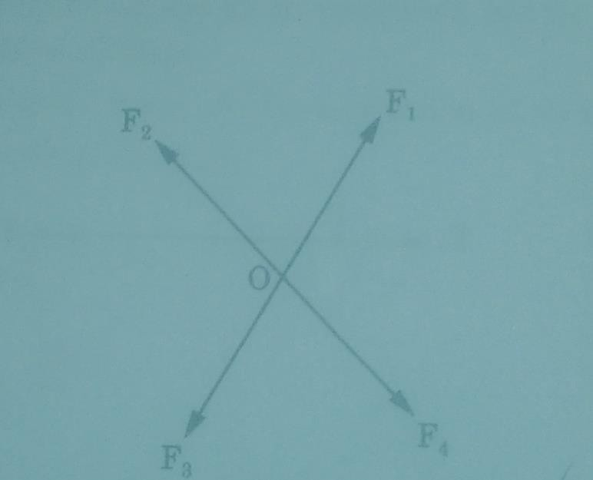
Force system
A force system is a collection of several forces acting simultaneously on a body in one or more planes. In fig the forces F1, F2, F3, and F4 constitute a force system.

Slide 12
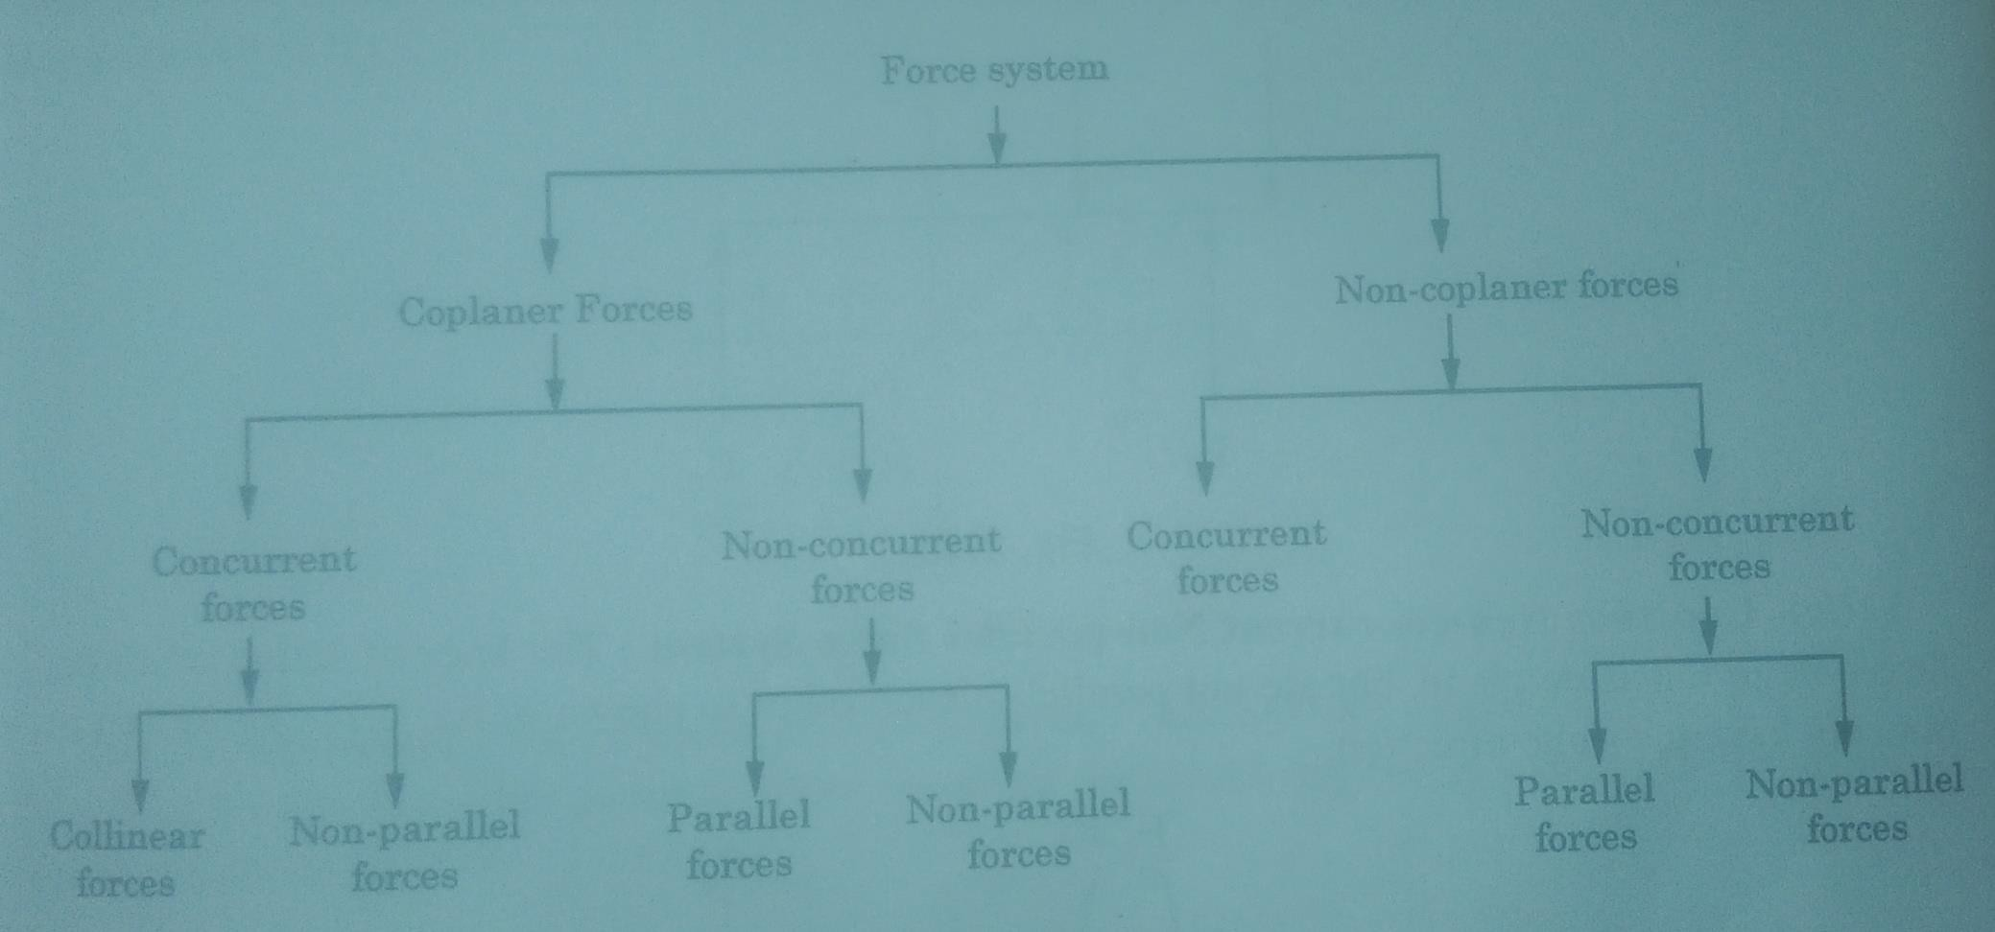
Coplaner force system
The force constituting the given system lie in the same plane. Coplaner force system may be classified as under:

Slide 13
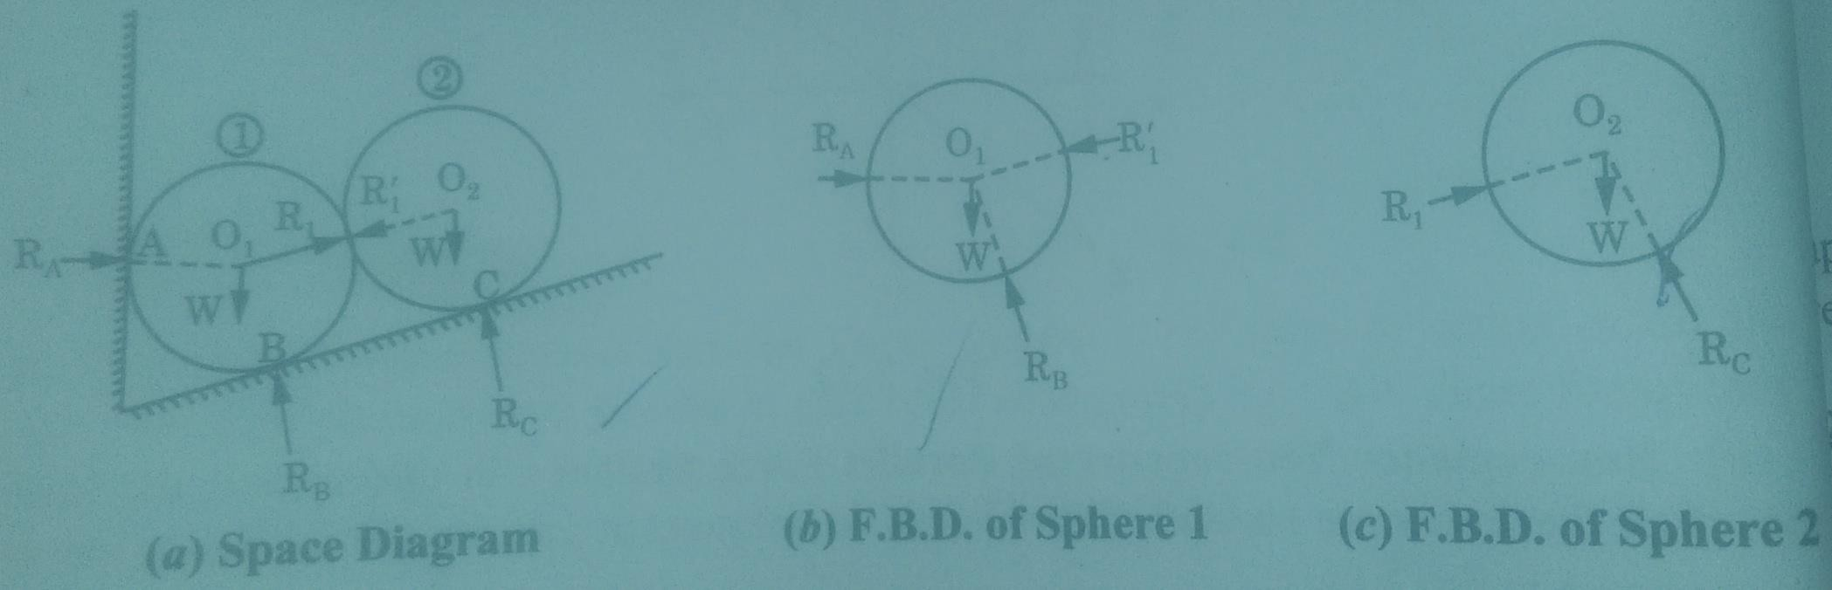
Free Body Diagram
To study the equilibrium of a body, it is imagined that the supports are replaced by the reaction exerted on body. A diagram of an isolated body which show only the reactions acting on the body is called a free body diagram (F.B.D).
The following steps are followed for drawing a free body diagram:
Draw a diagram of the body completely isolated from all
the bodies.

Slide 14
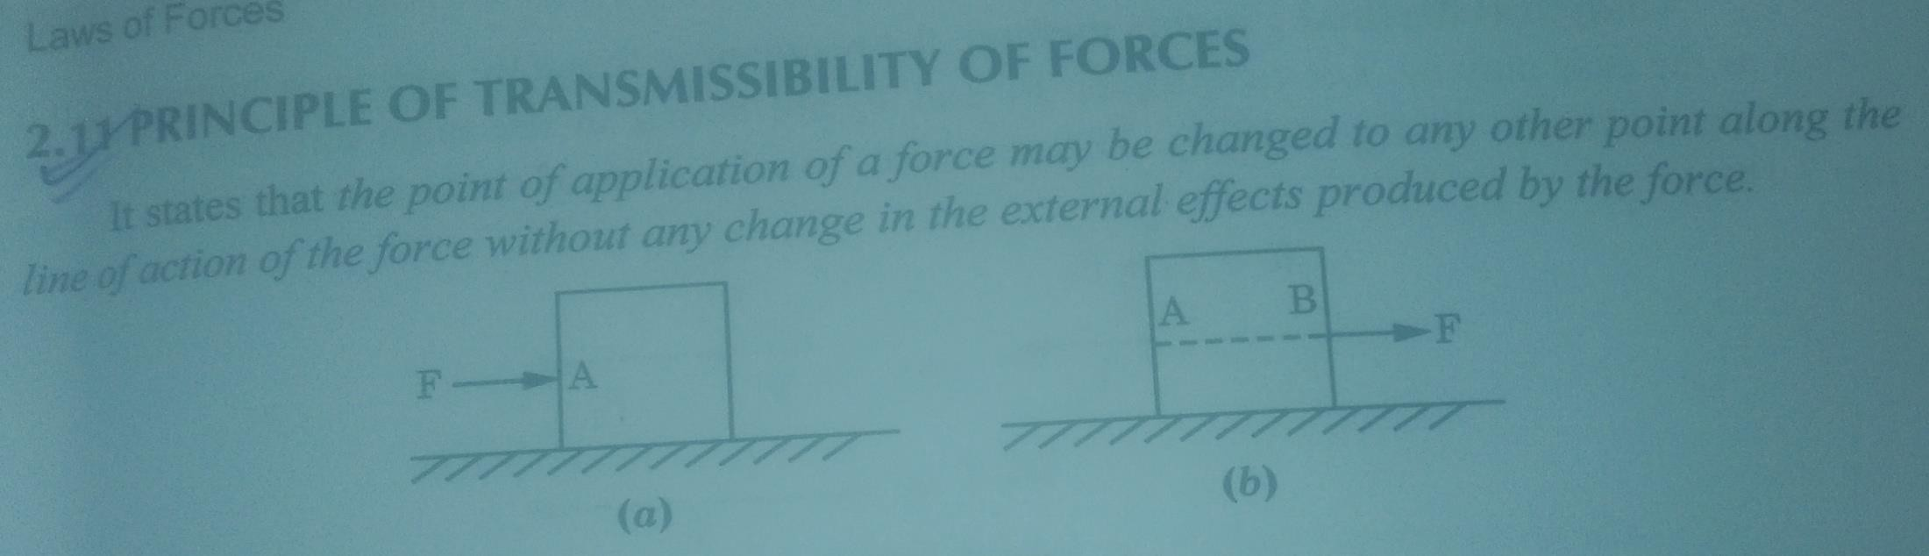
Law of superposition of forces
It states that the action of a given system of forces on a rigid body will remain same even if we add or subtract from them another system of forces in equilibrium.
Principal of transmissibility of forces
It states that the point of application of a force may be changed to any other point along the line of action of the force without any change in the external effects produced by the force.

Slide 15
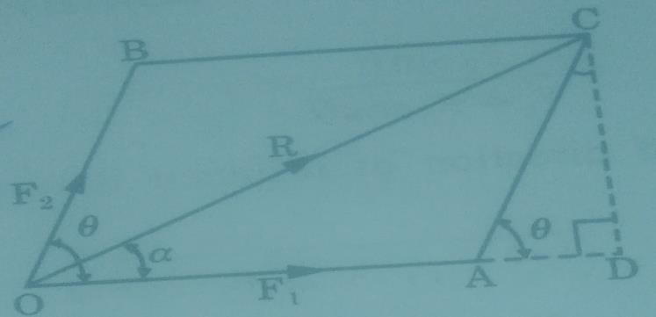
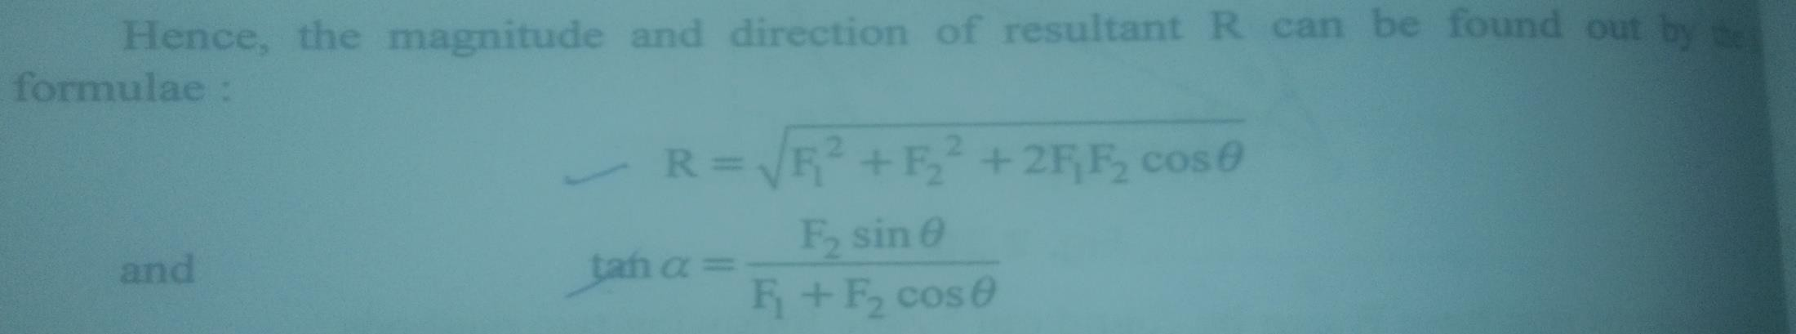
Parallelogram law of forces
Parallelogram law of forces states that if two forces acting simultaneously on a particle are represented in magnitude and direction by the two adjacent sides of a parallelogram, them their resultant is represented in magnitude and direction by the diagonal of the parallelogram passing through their point of intersection.

Slide 16
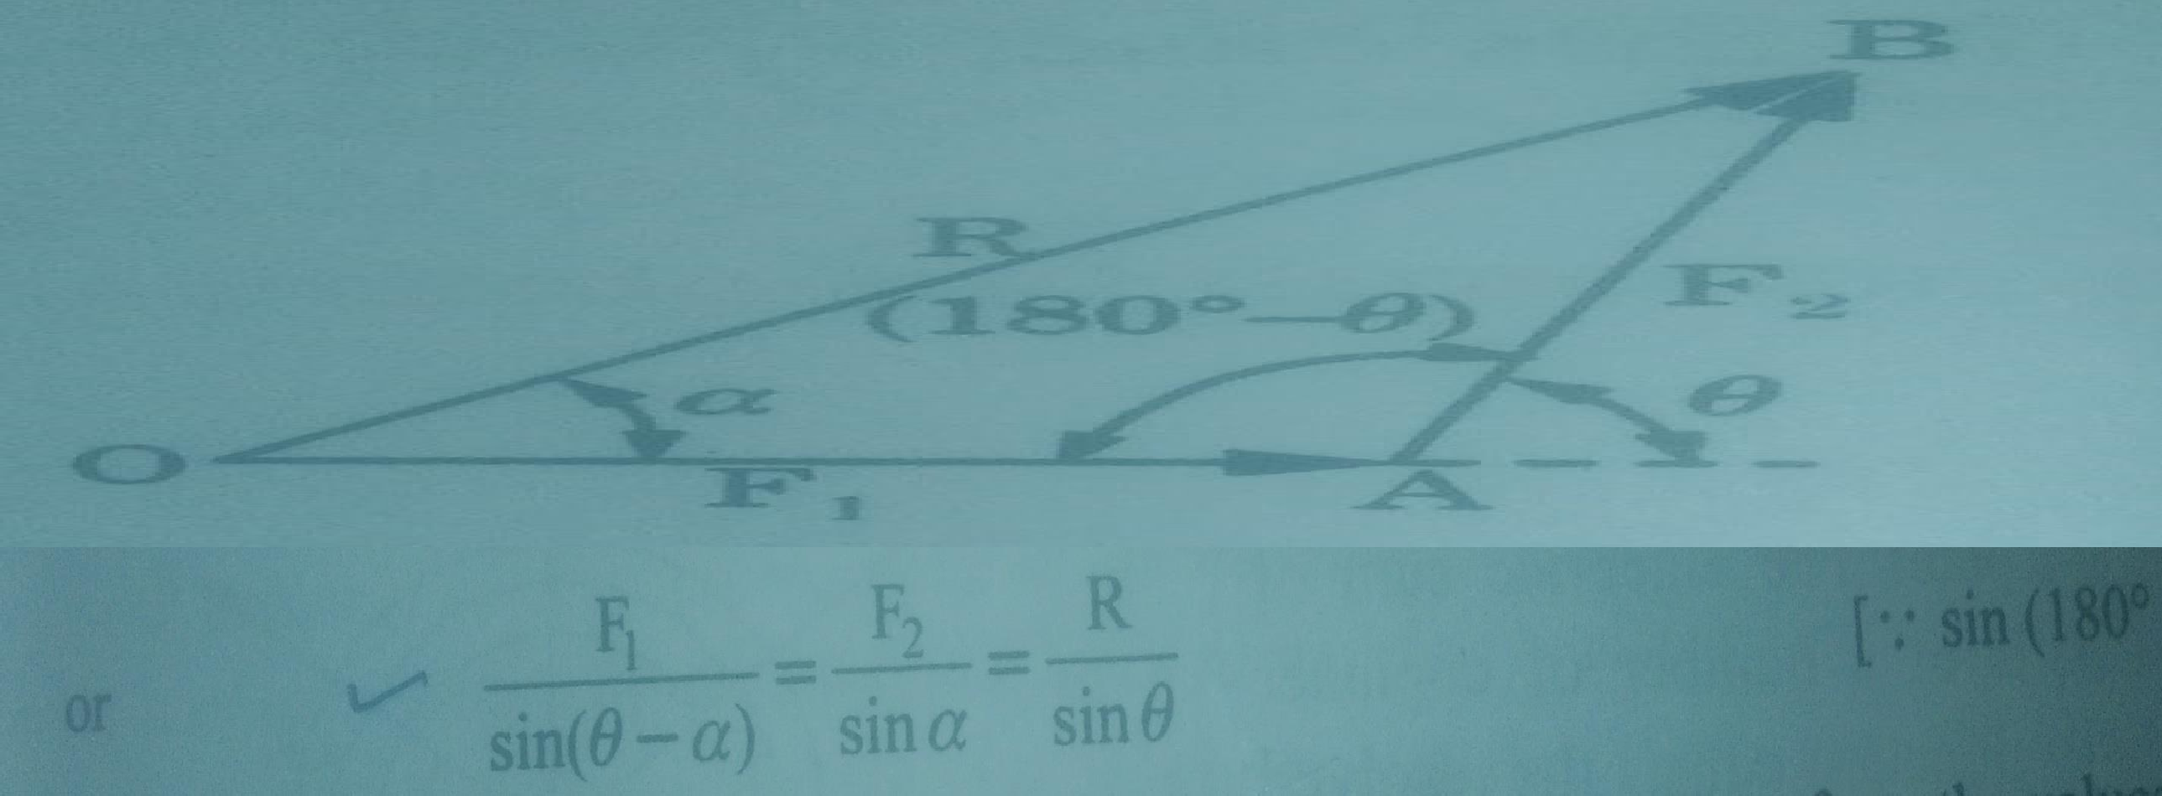
Triangle law of forces
Triangle law of forces states that if two forces acting simultaneously on a particle are represented in magnitude and direction by the two sides of a triangle taken in order, then their resultant is represented in magnitude and direction by the third side of the triangle taken in opposite order.

Slide 17
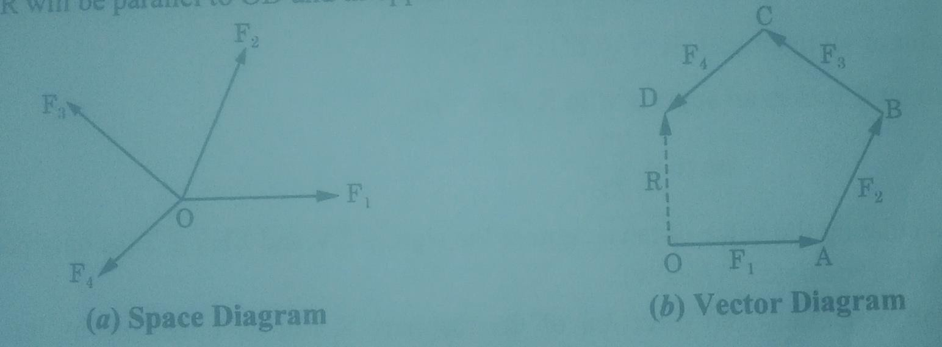
Resultant of a number of coplaner concurrent forces by polygon law of forces
Polygon law of forces is applied for finding the resultant of a number of coplaner forces acting at a point. It is a graphical method. It states that if a number of forces acting simultaneously on a particle are represented in magnitude and direction by the side of a polygon taken in order, then their resultant in represented in magnitude and direction by the closing side of polygon taken in opposite order.

Slide 18
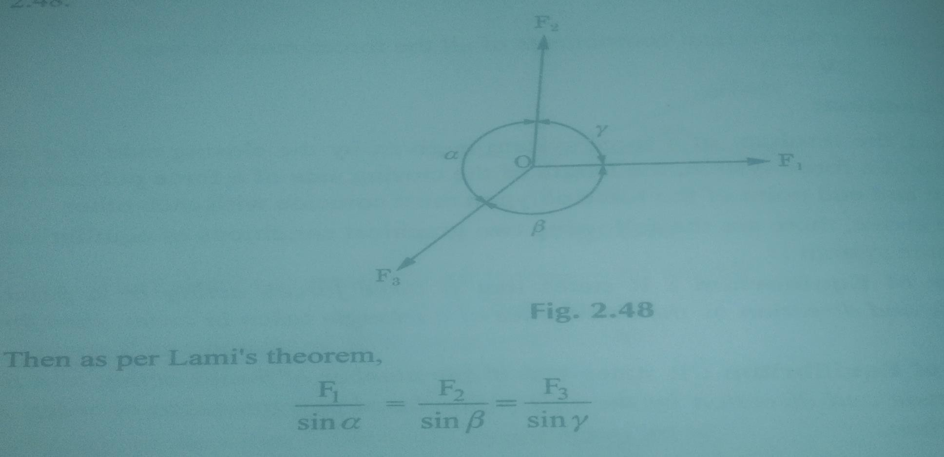
Lami’s Theorem
Lami’s Theorem states that if three coplaner forces acting at a point are in equilibrium, then each force is proportional to the sine of the angle between the other two forces.

