Slide 1
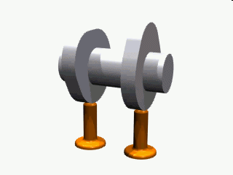
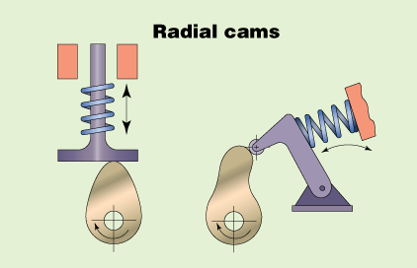
Cams
Prepared by: Mr. Navneet Gupta
Lecturer (Government Polytechnic College, Ambala City)

Slide 2
What Is a Cam?
A cam is a mechanical link which converts rotary motion into linear motion or vice versa.
A cam mechanism usually consists of two moving elements, The cam & the Follower Mounted on a fixed frame.

Slide 3
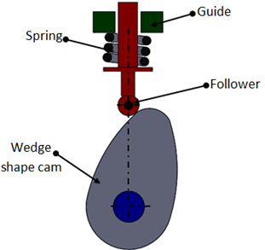
Cam Mechanism
Necessary elements of a cam mechanism are:-
A driver member known as the cam.
A driven member known as the follower.
A frame which supports the cam and guide the follower.

Slide 4
Types of Cam
Following are the commonly used types of cams:-
Plate Cam.
Face Cam.
Cylindrical Cam.

Slide 5
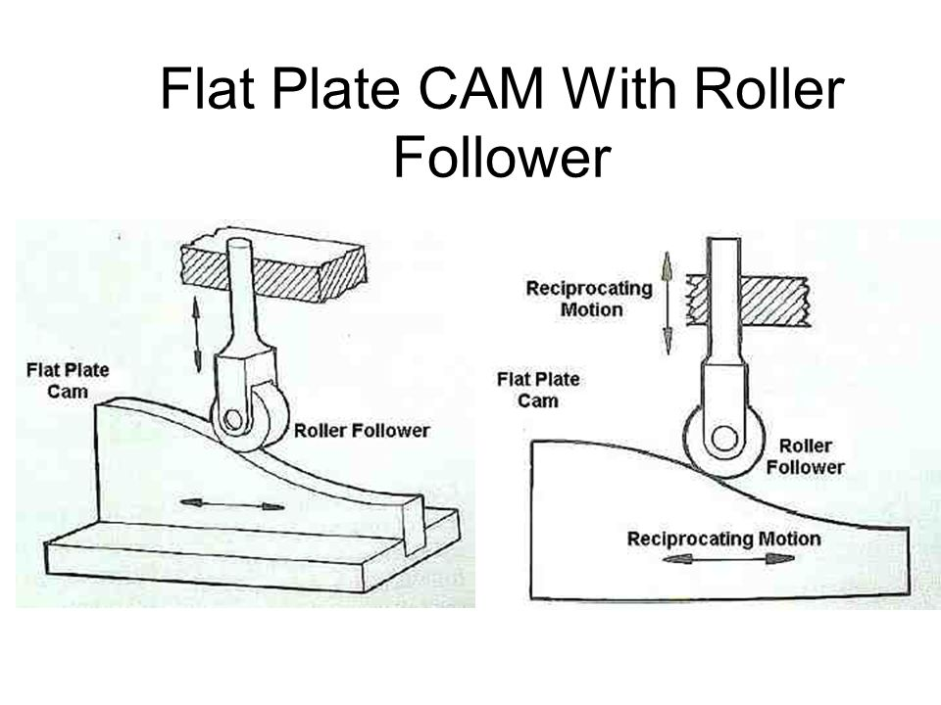
Plate Cam:-
Sometimes called a disc, radial or edge cam. Made up of
a flat plate or disc with an edge profile to transmit
motion.

Slide 6
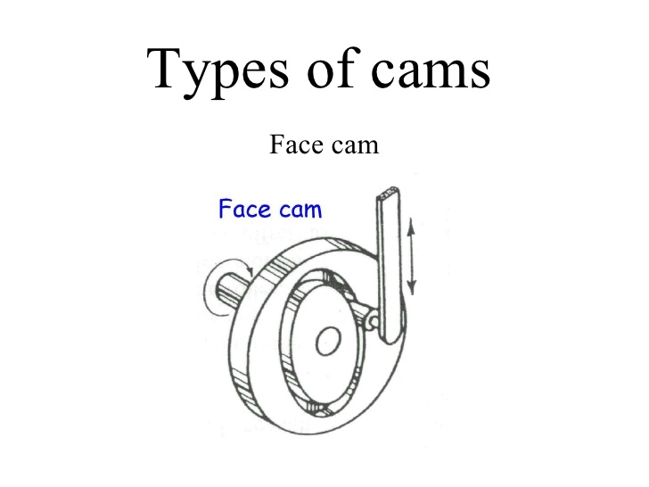
Face cam:-
In its flat surface, the rotary cam has a groove cut within follower riding on the face of a disk. Its motion parallel to the axis of cam.

Slide 7
Cylindrical cam:-
Sometimes called as a Barrel Cam. Its Curved Surface has a groove machined, within which a follower moves upwards. When follower reaches the top, The cam rotates in the opposite direction and moves back down.

Slide 8
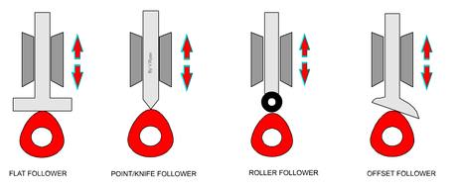
Types of Followers:-
There are different types of followers but the all slide or roll on the edge of a cam. Various types are shown below:-
Flat Follower
Point/Knife Follower
Roller Follower
Offset Follower

Slide 9
Cam Profile:-
Cams can be shaped in a number of ways and it is determined by the way the follower is to move. The shape of the cam is called the CAM PROFILE. Examples of various cam profiles can be seen below.
Pear Shaped Cam
Circular Shaped Cam
Heart Shaped Cam
Drop Shaped Cam

Slide 10
Cam Profile:-

Slide 11
Cam Profile:-

Slide 12
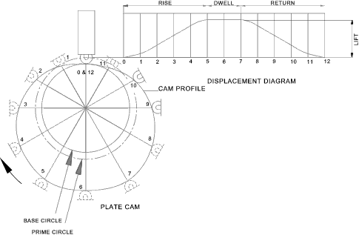
Cam Displacement Graph

Slide 13
Advantages
Easily designed to coordinate large numbers of input/output motion requirements.
Occupy less space.
Easy to obtain dynamic balance.

Slide 14
THANK YOU

